Slide 1
America, 1840-1895
Session 2: Dealing with a different culture: the Plains Indians’ way of life

Slide 2
America, 1840-1895 – Course Content​
Part one: Expansion: opportunities and challenges ​
The geography of North America: attitudes to the Great American Desert; the belief in ‘Manifest Destiny’.​
Why the early settlers went west and the challenges they faced: Brigham Young and the Mormons; the pioneer migrant farmers, the journey west; the miners.​
Dealing with a different culture: the Plains Indians’ way of life; early American Government policy towards the Plains Indians; the Permanent Indian Frontier; a changing relationship with the Plains Indians.​
Part two: Conflict across America ​
Increasing conflict on the Plains: the Fort Laramie Treaty (1851) and the failure of the policy of concentration; the Indian Wars (1862–1867): reasons for and consequences of the Wars; Sand Creek Massacre; Fetterman's Trap.​
The background to the American Civil War: differences between North and South, issues of slavery, westward expansion and free states abolitionism; breakdown of the Missouri Compromise, John Brown, the roles of Lincoln and Jefferson Davis; the social and economic impact of the American Civil War on civilian populations. ​
Coming to terms with the Mormons: the Mountain Meadow Massacre and its aftermath.​
Part three: Consolidation: forging the nation ​
The aftermath of the American Civil War: the 13th Amendment; Civil Rights Act; reconstruction in the South, 1866–1877; carpetbaggers; the balance of Federal and State powers. ​
The continued settlement of the west: the Homesteaders, reasons for going west; government actions and laws; land and railroads; farming problems and solutions. ​
The resolution of ‘the Indian problem’ after 1865: the small reservations policy; attitudes to the native Americans; Battle of the Little Big Horn; The Dawes Act; Battle of Wounded Knee; the closing of the frontier and its impact on native Americans.​

Slide 3

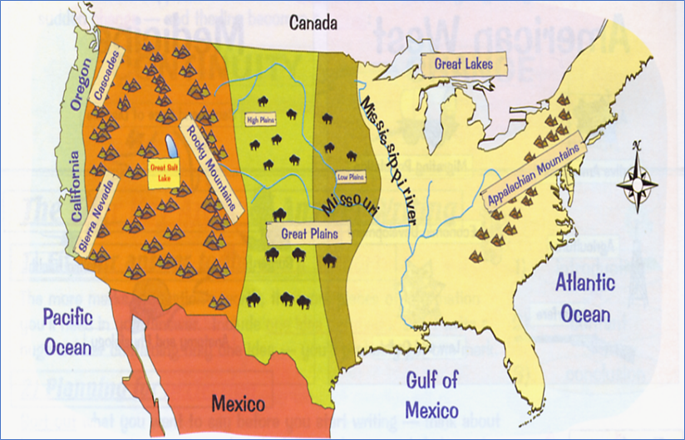
Part 1: Expansion, Opportunities and Challenges
Dealing with a different culture:
the Plains Indians’ way of life;
early American Government policy towards the Plains Indians;
the Permanent Indian Frontier;
a changing relationship with the Plains Indians.
Where was Indian Country?
Where was the Permanent Indian Frontier?

Slide 4
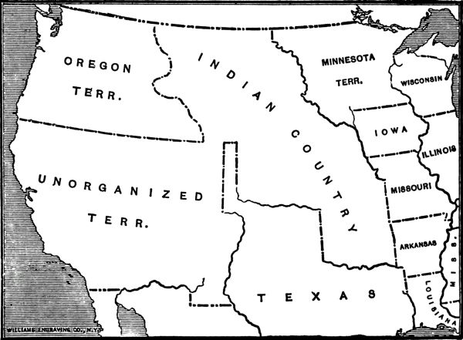
The Permanent Indian Frontier
The Indians were promised the Plains to themselves when they were forced to move from the East in the 1830s. The border of the Plains was known as the Permanent Indian Frontier and the Government said that this was going to last forever.
From this point forward, the Great Plains were now seen as 'one big reservation' and by 1840 all the Indian tribes had moved west of the Permanent Indian Frontier due to the Indian Removal Act 1830.
‘One Big Reservation’​​ | ‘One Big Reservation’ was the term given to the land behind the Permanent Indian Frontier – the land of the Plains which white Americans believed was uninhabitable and impossible for white man to settle. ​​

Slide 5
How did this come about?
A flow diagram showing the different stages in early government policy towards the Indians between 1830 and 1851.
Before the 1830s nearly 125,000 Native Americans lived on millions of acres of land in Georgia, Tennessee, Alabama, North Carolina and Florida – land their ancestors had occupied and cultivated for generations. By the end of the decade, very few natives remained anywhere in the south eastern United States.
Remember – you have all of this information on your America Knoweldge Organiser Part 1.1

Slide 6
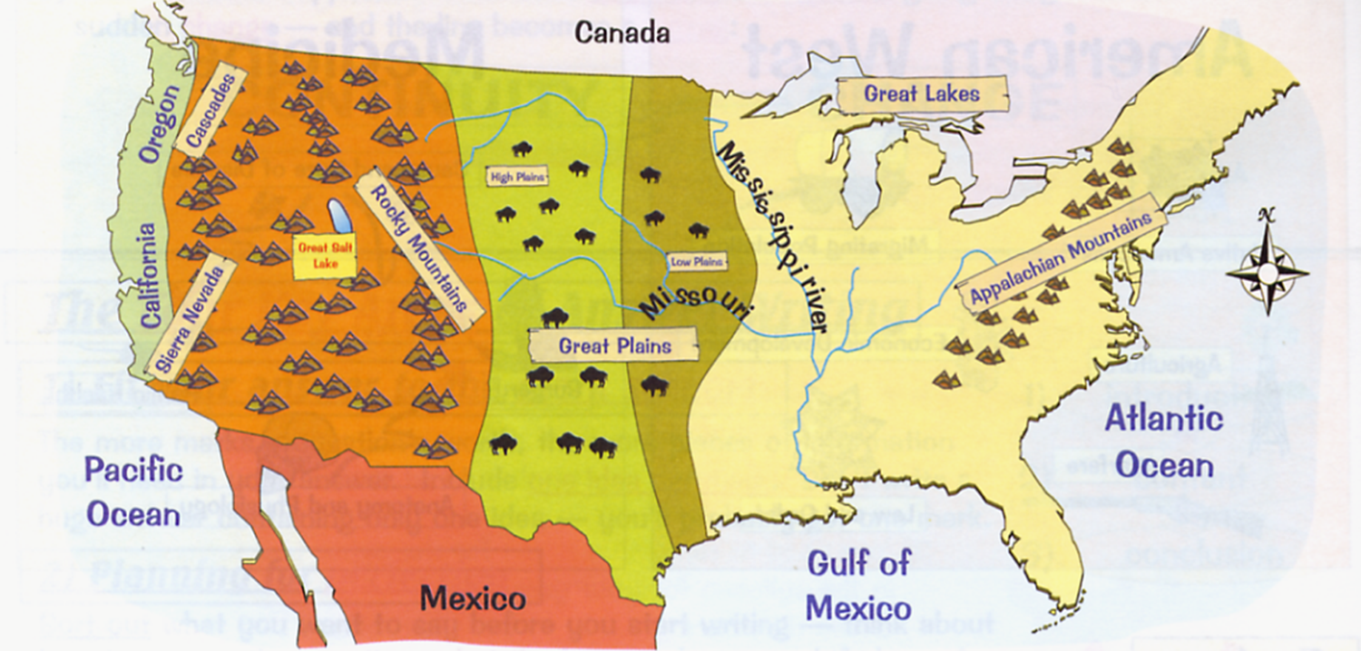
1. 1830 – Indian Removal Act (Indian Removal Act)
President Jackson signed the Indian Removal Act in 1830.
This forced 46,000 Indians (like the Cherokee) living in the East to move on to Indian Territory, west of the Mississippi.
The Indians were promised this ‘Indian Territory’ forever.
The whites had no interest in this land – they referred to it as the ‘Great American Desert’.

Slide 7
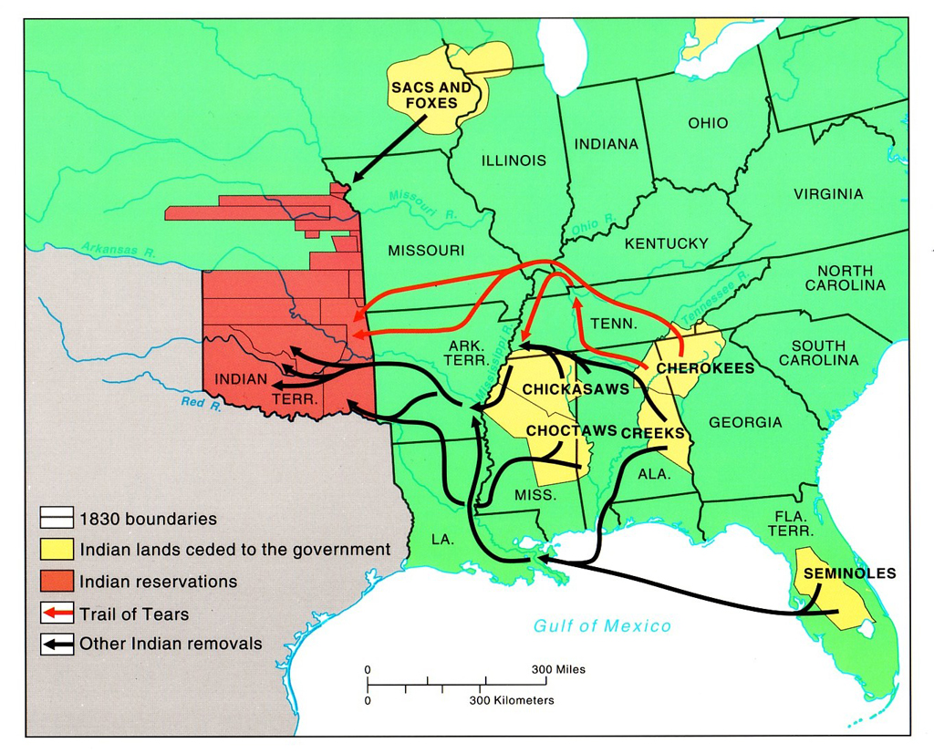


Slide 8
2. Consequences of the Indian Removal Act, 1830
This established a Permanent Indian Frontier – lands west of the Mississippi, to keep whites and Indians apart.
This land became known as Indian Territory.
This measure was described as being for their protection, but thousands died during the forced removal known as the ‘Trail of Tears’. ¼ of all Indians died of disease, starvation, exhaustion.
It basically allowed the forced removal of south-eastern Indian nations so that their lands would then be available for white settlement.
These Indians were now seen as people under the control of the United States.
These Indians were promised this land for good.
The removal process was pretty much complete by 1838.

Slide 9
3. A change in attitude in the 1840s:
By 1840, the eastern tribes had been moved onto the Plains – around 70,000-100,00 people in total.
White attitude to Indian Territory changed in the 1840s, when the Great Plains became a barrier for settlers moving to California and Oregon, to the miners heading for California and to the Mormons heading to Salt Lake City.
It is estimated that between 1840 and 1848, 11,500 Americans took the overland trail to Oregon and 2,500 to California.
During this great movement of people, there were few violent incidents between travellers and the Plains Indians, but a change in attitude was happening.
The intention was that the Native Americans would live on the Great Plains, while settlers farmed the land in the East. At this point, settlers did not want to settle on the Plains themselves because they thought the conditions on the Plains were unsuitable for living and farming.

Slide 10
4. Changing attitudes – the Indian Appropriations Act, 1851
By the 1850’s, more travellers were crossing the Plains and settlers were moving beyond the Permanent Indian Frontier on to the Eastern edges of the Plains.
Westward movement was encouraged by the government and the belief in Manifest Destiny, but it made the Plains Indians’ need for protection more pressing.
In the 1850s, people also began to see the possibility of settling on the Plains – it wasn't quite the 'Great American Desert' they had thought.
Meanwhile, US government policy focused on trying to ‘civilise’ the Indians by confining them to more concentrated RESERVATIONS.
The outcome of this was the US government policy was the Indian Appropriations Act of 1851.
This set up legally recognised reservations intended to protect Indians from westward expansion.
In 1854, the government opened up Kansas and Nebraska for settlement.

Slide 11
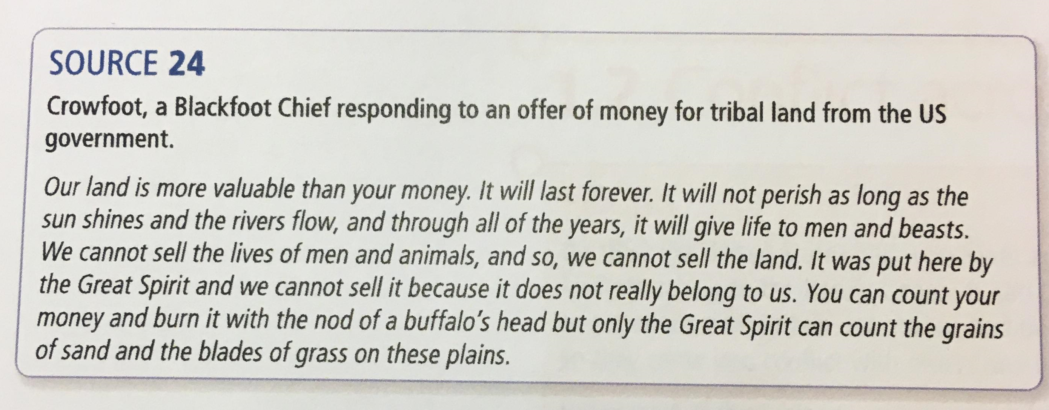
5. Consequences /Impact:
The Americans were beginning to see the land of the Great Plains from the point of view of ownership and settlement, but the Plains Indians believed no one could own the land.
At the core of Indian religious belief was the circle of life and they came from the earth just like all animals, and when they died they returned to the earth.
As well as a clash over land, there was a clash of cultures, as neither side fully understood the other.
Look carefully at this source. Underline anything which shows the difference in attitude towards land.

Slide 12
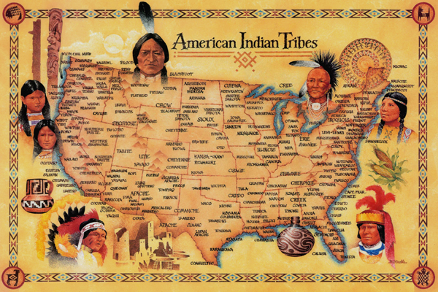
Plains Indians Way of Life: Background
While many US citizens saw the Great Plains as undesirable, it was the home of the Plains Indians, who had adapted their lifestyle to living in the harsh environment of the Plains.
The original Indians are believed to have come to America from Asia many centuries before European explorers arrived on the continent.
Native Americans were often grouped into tribes or nations. These groupings were generally based on peoples that shared the same culture, language, religion, customs, and politics. There were over 1000 Native American Tribes in the United States.

Slide 13
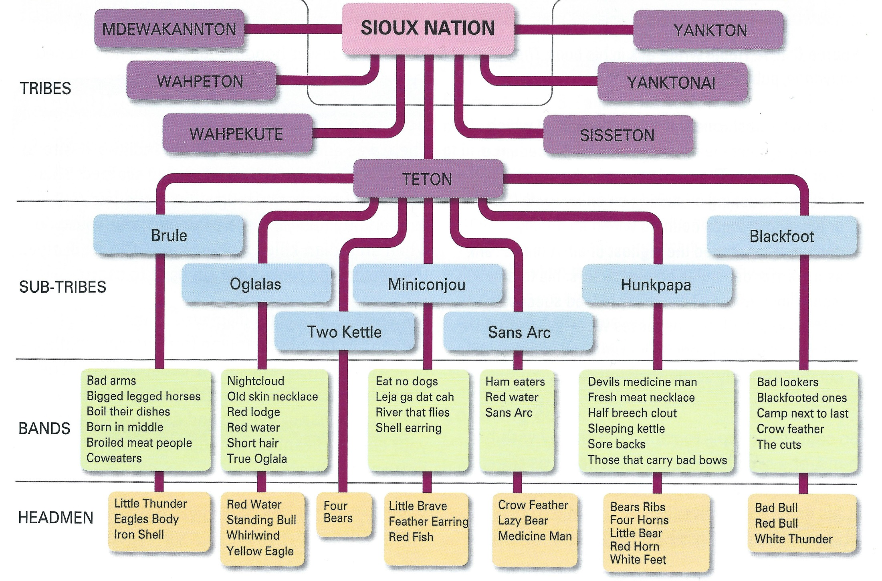
Nations, Tribes and Bands
The Plains Indians weren't a single group with a single culture – there were many different Nations, such as the Sioux, Comanche and Apache.
Each Nation was never led by an individual and was consisted of many tribes and sub-tribes. These were led by chiefs of bands and were advised by leading council members from the bands. Each sub-tribe consisted of many bands (smaller groups). Each band was led by a chief, advised by a council of all men and influenced by a warrior society. A chief did not have complete control, but he would have earned loyalty over the years by demonstrating courage and generosity – this gave him influence.
Most Nations were nomadic, hunting the millions of buffalo that lived on the Plains, e.g. the Lakota Sioux regularly moved from place to place. Other tribes were more settled and lived in one place, farming the land.
Tribal warfare was common. The aim wasn't necessarily to kill, but to perform acts of bravery, such as stealing horses or counting coup (getting close enough to an enemy to touch him).
CHIEFS
Test your knowledge:
Do you know what the role of the warrior society was?
Could explain how decisions were reached in the councils?
Why did the Indians travel in bands?
If not, you must go home and revise from your Knowledge Organisers and notes in exercise books. Or, look at p. 20-21 of the American West textbook!

Slide 14
A different lifestyle to white settlers...
Land – the Native Americans didn't see land as something that could be bought and sold. Land belonged to everyone. Even for more settled tribes, agricultural land belonged to a tribe as a whole.
Religion – The Indians were very spiritual beings. Medicine men and medicine women were spiritual leaders of tribes. Native American religious beliefs were closely linked to nature - humans were believed to be part of nature, not masters over it. Most tribes believed in the Wakan Tanka, 'Great Spirit', which created the world, and that everything in nature contained spirits which they believed needed to be kept on their side. Ceremonies and dance rituals (Buffalo Dance / Sundance) were performed to contact the spirits.
Women did most of the work in the village or camp, while men hunted and fought. Although men were head of the family, women owned the tipi and its contents, which gave them status. Children were seen as precious and were taught the survival skills needed to survive on the Plains – girls played with mini tipis and travois, whilst boys played hunting games.
Many tribes practiced polygamy because the dangers of hunting and warfare meant there were often more women than men in tribes/bands. Men and Women had distinct roles, which when combined together, ensured the survival of the band.
Remember - Settlers failed to understand the culture of the Plains Indians because it was so different to their own. They thought the Indians were childlike, savage and barbaric; a people who needed to be civilised by them. This led to tension and conflict.

Slide 15
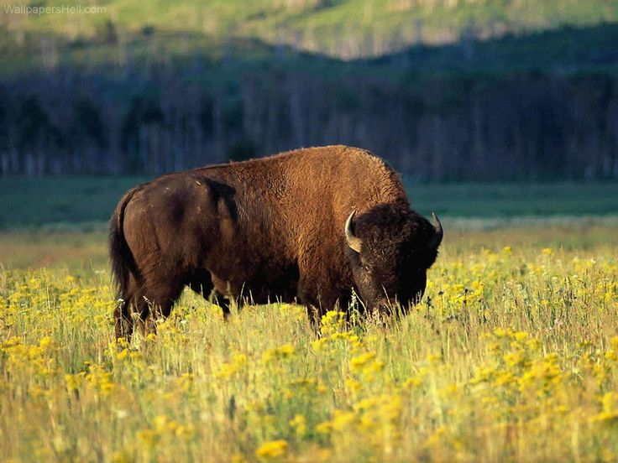
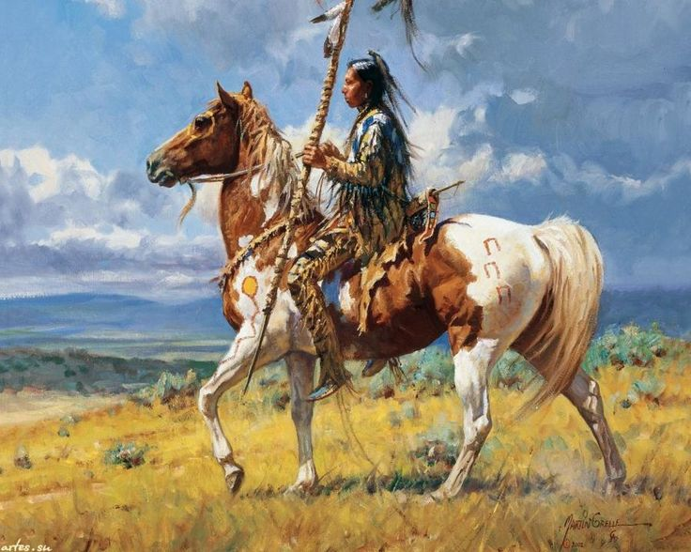
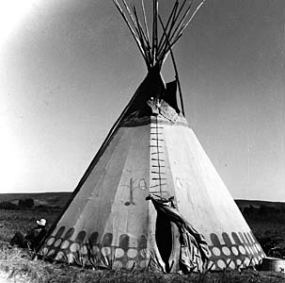
There were three key aspects to Indian survival on the Plains. These were...
For the exam you must be able to explain the importance of each of these in some detail. Can you?

Slide 16
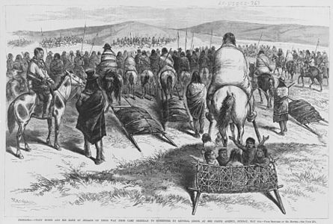
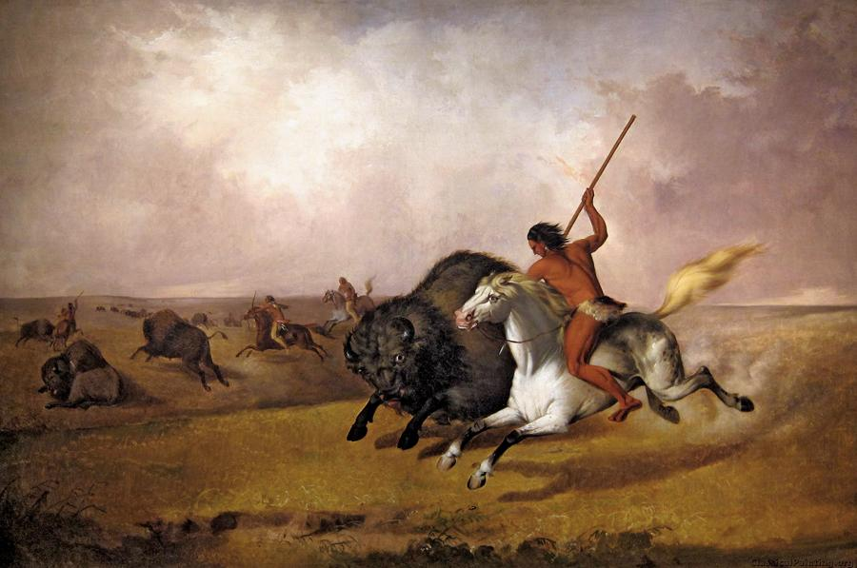
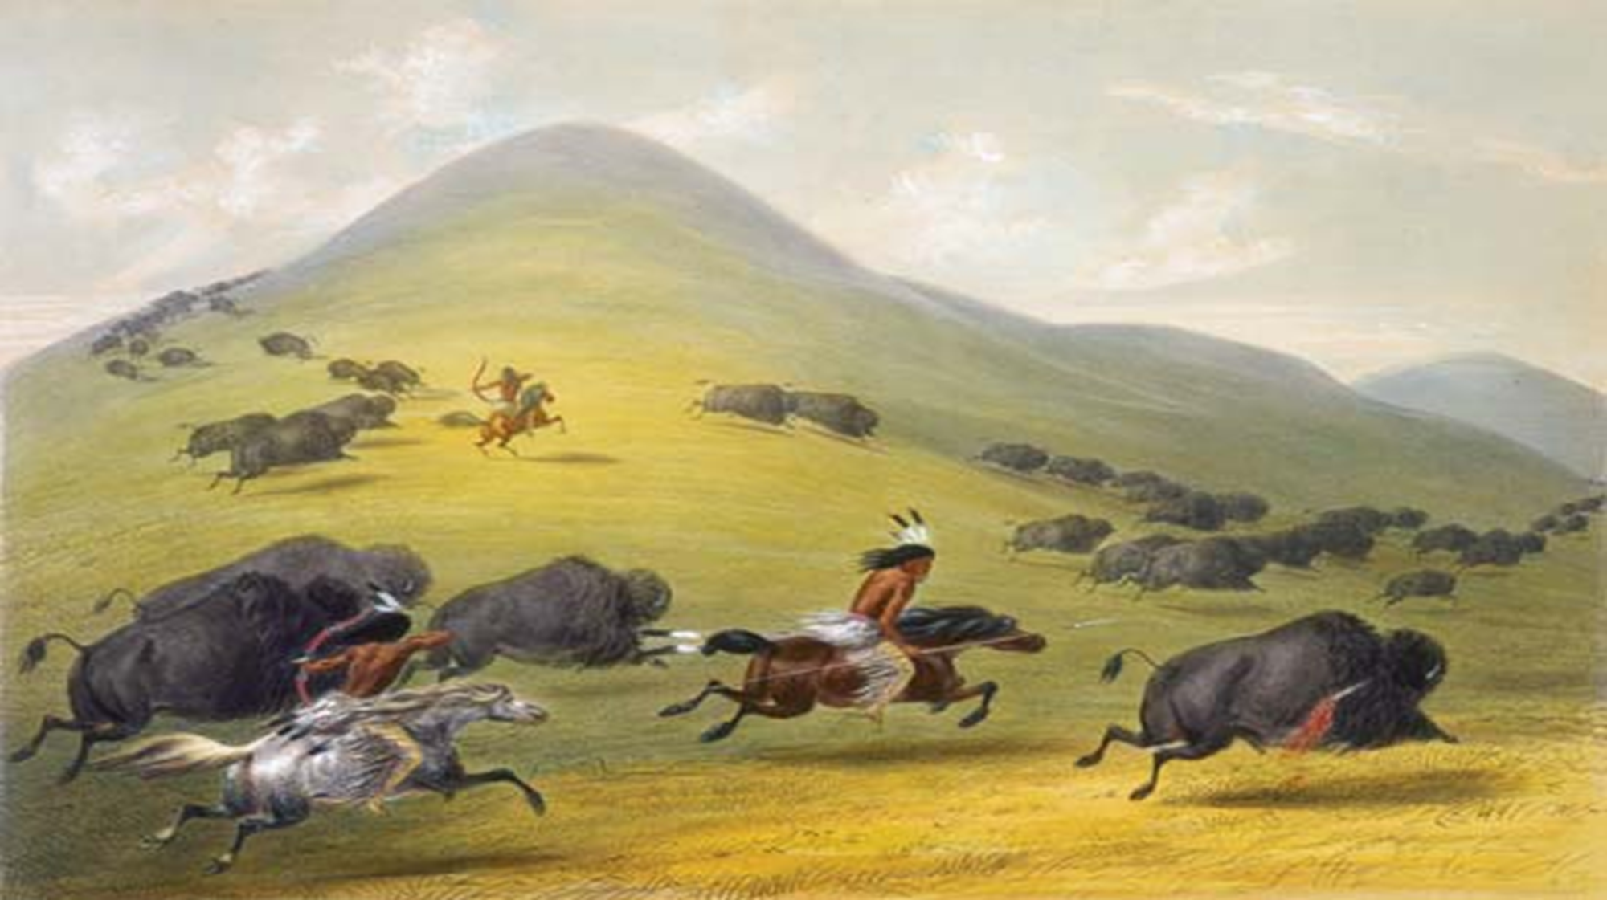
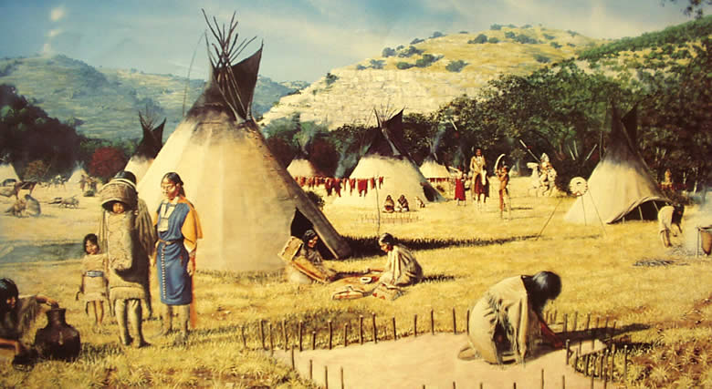
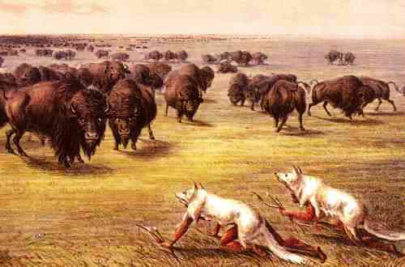
What can you learn from these sources about the importance of the buffalo to the Plains Indians?
The buffalo was a sacred animal and only the exact number of buffalo needed at that time were killed in a hunt. Indian survival relied on the buffalo herds to flourish, so they were not wasteful. Buffalo calves were never killed.
Hunting buffalo was key to their survival as buffalo provided everything they needed to survive on the Plains.
The need to travel to follow the moving buffalo herd led to a nomadic life
Buffalo hunting changed and became easier over time. The arrival of the horse in the 16th Century made hunting more efficient and accurate.
The buffalo provided the resources needed for survival:
Shelter
Clothing
Food
And much more

Slide 17
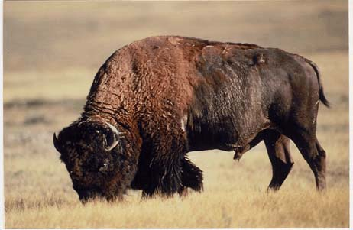
BRAIN
Tanning (mashing it up and spreading it on the hide to make it waterproof).
RAWHIDE
Belts, shields, all types of bags and containers, horse harness and travois lashing, ropes, string.
TAIL
Fly swats, ornaments.
TANNED HIDE
Tepee covers, robes, moccasins, leggins, clothes, saddle blankets, bags, dolls.
SKULL
Tool for de-hairing rope, used in religious ceremonies.
101 uses of the buffalo
DUNG
Fuel (known as buffalo chips).
HORNS
Cups, spoons, ladles, headress ornaments, toys, arrow straighteners.
HAIR
Rope, decoration on clothing, stuffing for saddles and pillows.
TONGUE
Hairbrush, food.
STOMACH
Cooking vessel, buckets.
MUSCLE SINEWS
Bowstrings and thread.
BONES
Knives, tools, arrow heads, saddle frames, needles, slege runners, dice.
FLESH
Meat eaten raw (usually the tongue and liver, or cooked, or dried and eaten during the winter when hunting was harder).
FUR
Winter robes, sleeping blankets, clothing.
FAT
Soap, cooking.
HOOVES
Glue, tools, rattles.

Slide 18
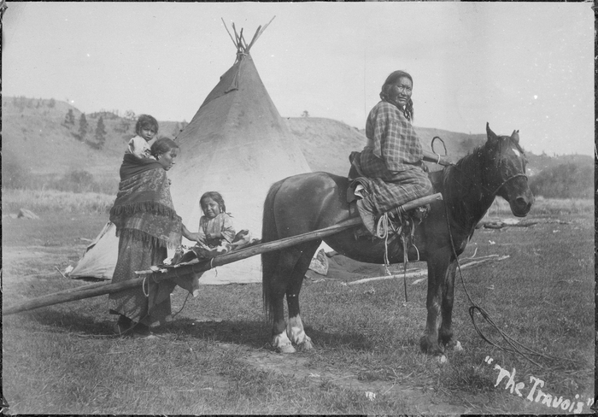
The arrival of the horse saw a change in hunting methods, as the Indians were now able to move and keep up with the stampeding buffalo, and only kill as many buffalo as were needed. Hunting methods used before the arrival of the horse were both dangerous and had limited success. For example, the use of 'buffalo jumps', where the Indians would cause a stampede and try and direct the buffalo to fall off a cliff, caused too many buffalo deaths. The method of wearing wolf hides to sneak up on buffalo caused the buffalo to stampede, which was both dangerous and made it impossible to keep up with the buffalo on foot.
The horse allowed the Indians to move more quickly to follow and keep up with the roaming buffalo. A travois would be attached to the back of the horse, where their belongings (and children) would be placed and then dragged behind.
Remember – the horse was so important to the Indians that they judged their wealth based on the number of horses they owned. Also, Indian warfare/raids were often carried out to steal horses. Horses provided transport and an effective way of hunting – both needed to follow and hunt buffalo, their main resource!
What do these images tell us about the importance of the horse to the survival of the Indians?

Slide 19
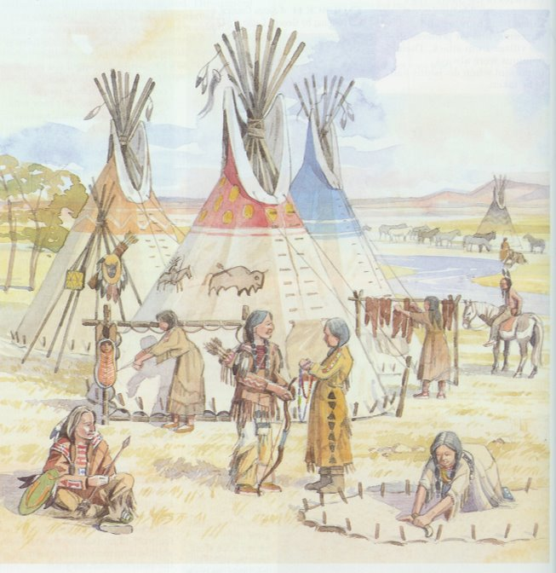
The importance of the tipi
The Indians relied on the buffalo to survive. But the buffalo herds moved around with the changes to the seasons.​
​
This meant that the Plains Indians had to move too. Therefore they could not build houses that would stay in one place. This meant that the Plains Indians had to be nomadic.​
​
Indian homes would have to do certain things in order to allow them to be nomadic:​
Be easy to build and not need much wood​
Be able to move around – pack up quickly and be put up quickly​
Overcome the extremes of weather - be able to keep them warm in the winter and cool in the summer​
Overcome the lack of wood and be easily repairable
Be able to survive the strong winds all year around.​
​
The tipi did all of these things, and therefore allowed the Indians to survive on the plains.

Slide 20
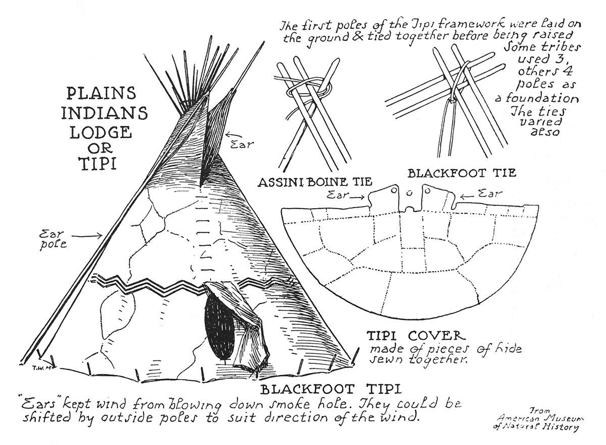

Slide 21
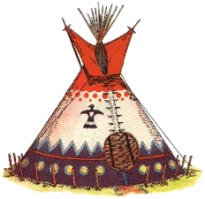
Why was the tipi ideally suited to the lifestyle of the
Indians on the Great Plains?’
2. Overcame the strong winds
The tipis conical shape made it aerodynamic, thereby protecting it from the strong winds.
1. Overcame the lack of wood
The wooden structure of the tipi was re-used over and over again. 10-20 yellow pine poles were stripped so that they lasted even longer.
4. Easy to repair
The outer and inner covers were both made of buffalo hides, which were not in short supply.
3. Overcame the extremes of ​
Temperature​
​
In the summer, the outer tipi cover could be rolled up so that cool air could enter the tipi. In the winter, earth would be packed up against the bottom of the tipi, so that not heat would be lost. There was also a constant fire burning.​
5. Easy to pack away and put up
The tipi could be packed away and put up in around 10 minutes. This was essential as they needed to move with the buffalo, and they needed protection from the extremes of weather.
6. Easily transportable
The tipi was easy to transport despite its size. It would be taken down and packed on to the back of the travois.

Slide 22
Paper 1 Section A: America, 1840-1895
Exam Questions
How do Interpretations A and B differ? (4)
Why do Interpretations A and B differ? (4)
How convincing are interpretations? (8)
Describe two … (4)
In what ways … Explain your answer (8)
Which of the following were more important? 2 bullet points – could be on causes / consequences (12)

Slide 23
Question 2 - Why might the authors of Interpretations A and B have a different interpretation of the attack on the Indian camp at Sand Creek?
Explain your answer using Interpretations A and B and your contextual knowledge. [4 marks]
Interpretation A: George Bent in a letter to the historian George Hyde, which was sent between 1905 and 1918. Bent was born in 1843. He had a Cheyenne Indian mother and a white father who ran the local trading post at Sand Creek. In 1864 he was staying with his mother’s ​relatives at Sand Creek.
Interpretation B: William Byers in a letter to the New York Tribune, an East coast newspaper, in February 1880. Byers was the editor of the Rocky Mountain News, a newspaper in the mining town of Denver, Colorado, at the time of the Sand Creek attack in 1864.

Slide 24

Tune – It's all about the base
Question 2: It's all about the author, about the author. No content!
This would gain the full 4 marks available: Why?​
​
Interpretation A is different to B because George Bent was present at the time of the Sand Creek Massacre and was related to the Cheyenne Indians who were there. Therefore, he was furious with the soldiers who attacked because most of the Indians at Sand Creek were killed, which means that some of his relatives could have died. Interpretation B is different because he wants to defend the soldiers who attacked the camp. William Byers was from Colorado and so were Chivington’s soldiers. Therefore, Byers could have known the soldiers who were involved in the attack and wants to defend their reputation in a New York newspaper.

