Slide 1
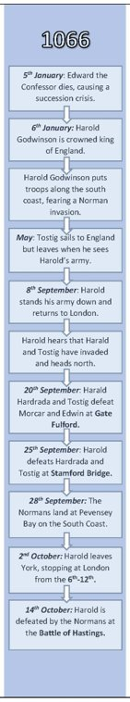
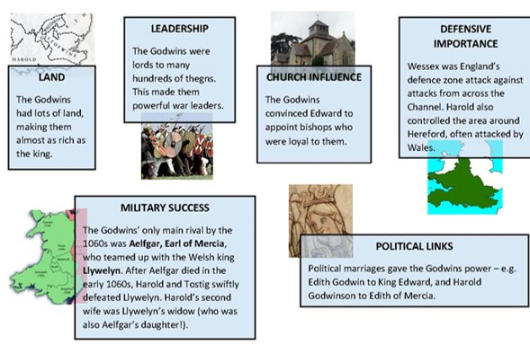
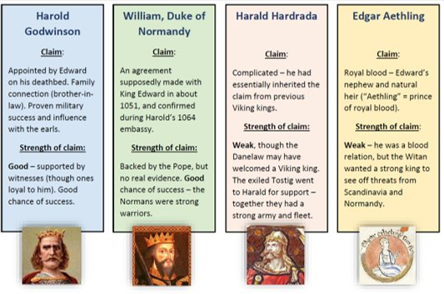
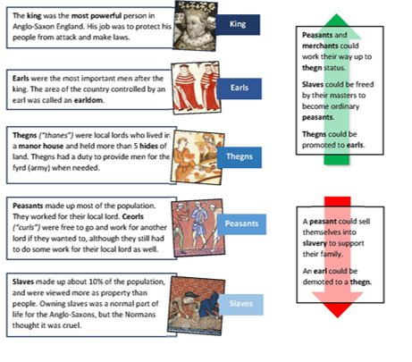
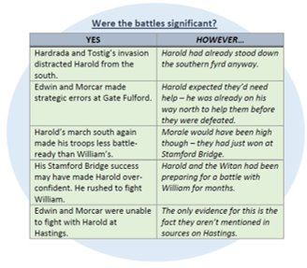
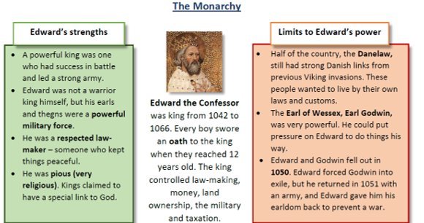
Knowledge Organiser – Normans, c.1066-1100. Part 1: The Normans: Conquest and Control
An overview of what you need to know for Part 1: The Normans: conquest and control Causes of Norman Conquest, including the death of Edward the Confessor, the claimants and claims. Military aspects: Battle of Stamford Bridge; Battle of Hastings; Anglo-Saxon and Norman tactics; military innovations, including cavalry and castles. Establishing and maintaining control: the Harrying of the North; revolts, 1067–1075; King William’s leadership and government; William II and his inheritance.
​​Exam Questions​​
Describe two key features of (4 marks)
Explain why…(12 marks)
To what extent do you agree with the statement that…(16 marks)
What was England like in Anglo-Saxon times? ​
​England had a population of about 2 million people (less than half of London today!) ​
Almost everyone farmed land. ​
England was a Christian country, and religion played a large role in everyday life. ​
For centuries England had been under threat from the Vikings, and parts of northern England had Viking settlers. ​
Edward the Confessor was king from 1042 to 1066, but the kings before him (Cnut and his two sons) had been Vikings. ​
England had a very well-organised government. ​
​
The Social System ​
At the top of Anglo-Saxon society were the King and the elite aristocracy, and at the very bottom were slaves.
Government
The king decided who was on the Witan and when it met. He did not have to follow its advice.
The Witan
The Witan was a council of advisers to the king, made up of important people like earls and archbishops. It discussed threats and disputes, and had a large role in choosing a new king.
Edward the Confessor’s Last Years: The role of the Godwin Family
Earl Godwin had been made Earl of Wessex by King Cnut in 1018. Godwin helped Edward the Confessor become king, and Edward was married to Godwin’s daughter Edith.
Why were the Godwins so powerful in Anglo-Saxon England?
Harold Godwin’s Embassy to Normandy
Harold Godwinson went to Normandy on a mission for the King (an embassy) in 1064.
WHAT HAPPENED?
Harold landed in Ponthieu, where Count Guy of Ponthieu took him prisoner.
William of Normandy rescued Harold.
Harold then spent time in Normandy, helping William in two military campaigns.
Harold made an oath to William – possibly swearing fealty to support William’s claim to the English throne.
WHY IS IT SIGNIFICANT?
It shows that Harold was Edward’s trusted adviser, as it was clearly an important embassy.
The Normans used it to boost William’s claim to the English throne.
After Harold took over as king from Edward in 1066, the Normans used this embassy to portray Harold as an oath-breaker.
Edward the Confessor’s Death
Edward died on the 5th of January 1066. He had no children, which meant there was a succession crisis. The Bayeux Tapestry shows Edward on his deathbed, holding out his hand to Harold. The Witan met quickly and Harold was crowned the same day as Edward’s burial, 6th January 1066. But there were 4 contenders for the throne.
​
Battle of Fulford ​​Gate
Harald Hardrada and Tostig attacked in September 1066. They were blocked just outside York by the new Earl of Northumbria Morcar and his brother Edwin (Earl of Mercia) at Gate Fulford. ​​
The battle was a defeat for Morcar and Edwin. Their mistake was fighting just outside York, rather than within the city walls. ​​
Harold heard about the invasion and marched north. He must have been confident that William would not attack the south any time soon ​​
​​
Battle of Stamford bridge​​
Harold surprised Hardrada and Tostig at Stamford Bridge. Both Hardrada and Tostig were killed.
Harold won because: ​​
The Vikings had left their
armour on their ships ​​
He had the element of
surprise ​​
Hardrada and Tostig had
fought at Fulford Gate 5
days before ​​
The Vikings were (wrongly)
under the impression that
the English hated Harold ​​
Harold’s men broke the
Viking shield wall.
Harold’s Coronation and Reign
Harold was crowned quickly because the Witan feared an attack by William. He faced several challenges as king: ​
Challenges from powerful earls - including old rival the Earl of Mercia ​
The north – would they accept Tostig’s brother as their new king? ​
Tostig – was looking for allies in Europe ​
William – was reportedly getting ready to invade ​
​
Harold met with other Witan members at York, Northumbria’s main city, to get their support. He positioned an army along the south coast, expecting an invasion attempt by William. They eventually stood down when the Norman invasion had still not come by September. ​Tostig sailed to England in May 1066, but he was put off by Harold’s strong defences. A fight with the Mercians at Lincoln left him with only 12 ships. ​

Slide 2
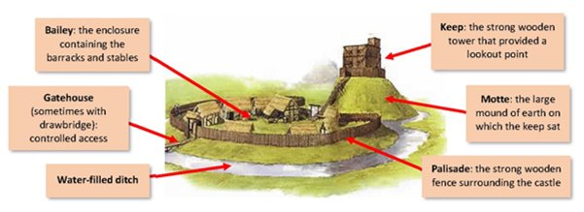
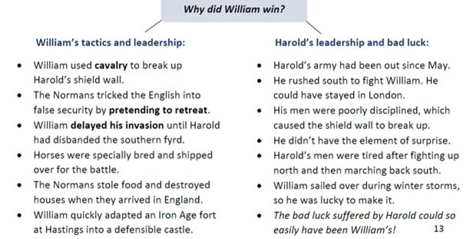
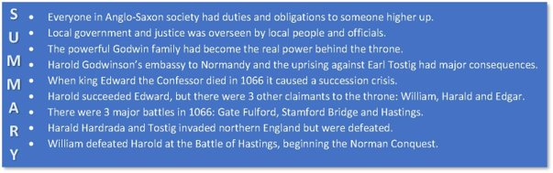
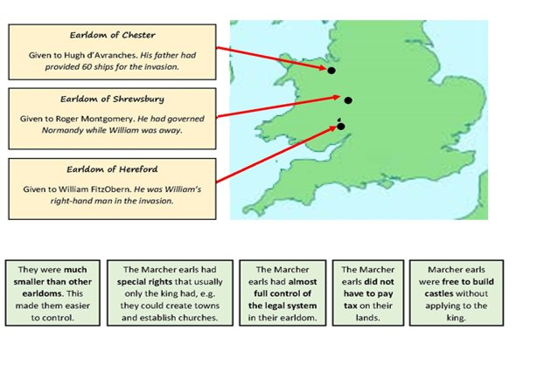
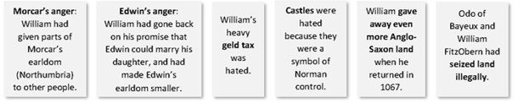
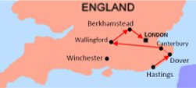
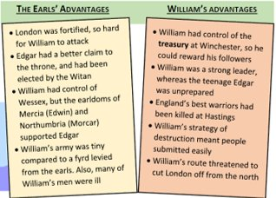
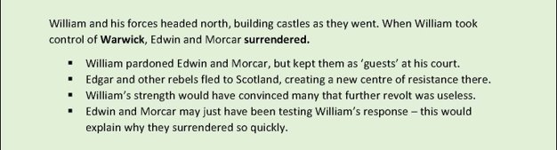
The Norman Invasion
What happened after Hastings? ​
​
2. Establishing Control
William was crowned on Christmas Day 1066. He swore an oath that he would rule England like the best Anglo-Saxon kings had, if the English would be loyal to him.
Rewarding Followers
William had promised land and money to the people who had helped him invade.
  He sent rich gifts to the pope and Church supporters in Normandy.
He introduced a heavy geld tax to raise money to pay mercenaries (fighters hired from other countries).
He gave land to family members and advisers. His half-brother, Odo, Bishop of Bayeux, was given all of Kent. Gospatric was made Earl of north Northumbria.
Rewarding Anglo-Saxons
William wanted a trouble-free takeover.
Earls like Edwin and Morcar kept their earldoms.
Archbishops like Ealdred (York) and Stigand (Canterbury) kept their positions.
He promised that Edwin could marry his daughter.
3. Establishing Control of the Borderlands
William wanted to make the border between England and Wales more secure.
He established the Marcher earldoms – three new earldoms centred on Hereford, Shrewsbury and Chester. (March was an Anglo-Saxon term for border).
All three earldoms were given as rewards to people who had been loyal to William.
The Marcher Earldoms (Marcher Lordships) were different to other earldoms:
​
​
These features meant the king and earls could control the border areas and quickly put down any unrest. The special rights also attracted people from Normandy to come and settle the regions (colonisation).
What happened after Hastings?
4. Building Castles ​
William built around 500 castles to establish his control around the country. The first castles were Motte and Bailey castles and had been brought as ‘flat pack’ castles ready to assemble in England. The first castle was built at Pevensey where the Normans landed. ​
The Castles had both a STRATEGIC and a SYMBOLIC purpose and helped William gain and keep control of England.
They were built in strategic places, such as near rivers or mountain passes or where there had been rebellions.
They were used as a base by the local lord and troops would be based inside.
Each castle was built approximately 1 day’s ride from the next so that the troops could support each other if there was rebellion or invasion.
Local people were made to build the castles, and in many cases houses would be demolished to make way for them.
Castles dominated the local skyline and were a symbol of Norman power.
Square Keep castles - Later castles were built out of stone which meant they were stronger and harder to attack and were a permanent reminder to the English of the Normans power.
The Battle of Hastings – 14th October 1066
After leaving York, Harold stopped in London for around 5 days to gather troops. He then continued south and met William at Senlac Hill, near Hastings.
The battle began in Harold’s favour, but his strong shield wall gradually broke down.
At one point a rumour went round that William had been killed, so he tipped his helmet to show he was still alive.
Harold Godwinson and his brothers Gyrth and Leofwine held their position on the top of the hill. Eventually they were killed, but their housecarls fought on to the last.
Anglo-Saxon England and Norman Invasion: A Summary
Anglo-Saxon Rebellions and Resistance, 1068-71:
1. The Revolt of Edwin and Morcar, 1068
William went back to Normandy in spring 1067. He took with him Edgar Aethling, Earl Edwin, Earl Morcar and Earl Waltheof. When he came back in December, Norman control was under threat. In 1068, Edwin and Morcar fled north and began a rebellion against William. They went north, where they were joined by others including Edgar, Waltheof and Gospatric.
Reasons for the Revolt:
What happened after Hastings? ​
​
1. The Submission of the Earls, 1066 ​
The Witan elected Edgar Aethling as king. ​
William sent troops to seize Winchester and marched towards London. He needed control of the south coast to get supplies over from Normandy. The Normans forced people to submit by destroying homes and farms as they went. However, William and many of his troops fell ill at Dover. ​ At Berkhamstead (near London) Edgar, archbishops Ealdred and Stigand, Edwin and Morcar submitted to William. They swore an oath to obey him.
​
​
​
​

Slide 3
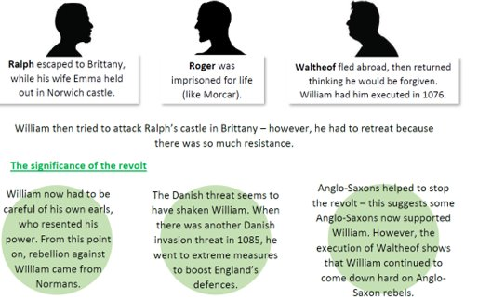
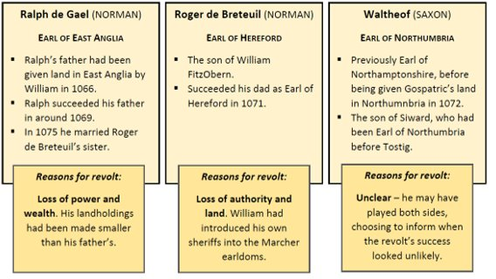
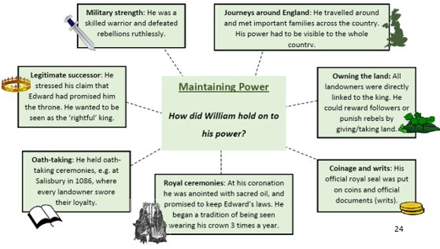
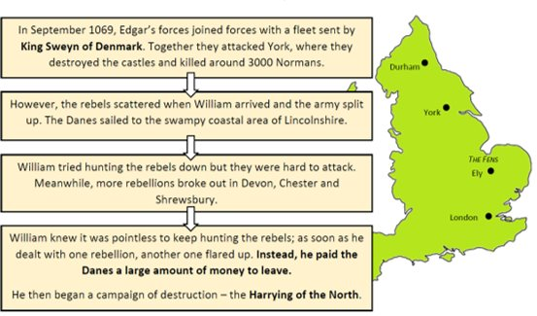
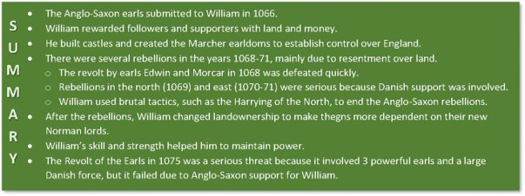
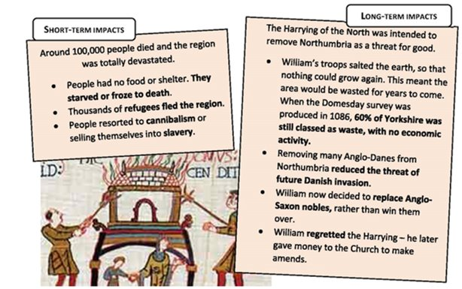
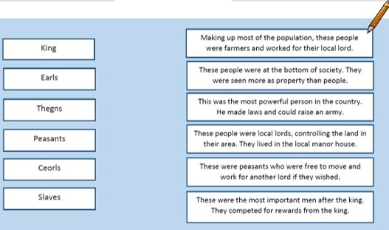
Anglo-Saxon Rebellions and Resistance, 1068-71:
2. The Rebellions in the North, 1069
Robert Cumin ​
After being betrayed by Gospatric in the 1068 rebellion, William chose a new Earl of northern Northumbria: Robert Cumin. Cumin violently attacked towns and villages as he went north, and a group of angry Northumbrians retaliated by killing him in Durham. ​
The uprising in York ​
An uprising began in York in around February 1069, and Edgar Aethling came down from Scotland to join the rebels. ​
William put down the rebellion and Edgar escaped back to Scotland. William had a new castle built at York and put William FitzObern in charge of it. He then returned to Winchester for Easter – carrying out royal ceremonies was important for William to be seen as a ‘real’ king. ​
3. The Anglo-Danish attack on York
William’s control came under more pressure throughout 1069.
4. The Harrying of the North, 1069-70
After the attack on York in 1069, William began the Harrying (devastation) of the North. This involved burning crops, killing livestock and destroying villages.
The Revolt of the Earls, 1075 ​
There was another revolt in 1075, but this time it included Normans rebelling against William, and Anglo-Saxons defending him. There were 3 Earls involved.​
The leader of the revolt was Ralph de Gael. He plotted with Roger de Breteuil and Waltheof to overthrow William and split the country between them.
Reasons for the revolt
The men were angry about their loss of land, loss of privileges and loss of power. William had been in Normandy since 1073, leaving Archbishop Lanfranc in charge of England. His absence gave the conspirators an ideal opportunity to rebel.
Planning the revolt
Ralph and Roger first discussed their plans with Waltheof at the wedding feast of Ralph and Emma (Roger’s sister). Lots of important earls and bishops were there.
Waltheof was the last surviving Anglo-Saxon earl and had good contacts with King Sweyn of Denmark. The men expected Danish support for their plan.
What went wrong?
1. Most Anglo-Saxons supported William.
2. Waltheof changed his mind and told Archbishop Lanfranc what was going on.
3. Lanfranc wrote to Roger, trying to convince him not to revolt. He threatened to excommunicate him (cut him off from the Church).
4. Lanfranc organised counter-measures. Norman and Anglo-Saxons worked together to prevent Roger and Ralph from breaking out of their earldoms.
5. By the time the Danish fleet finally arrived, William was back in England. The Danish leaders dared not fight him. They simply raided the east coast then went home.
5. Hereward the Wake and Rebellion at Ely, 1070-71
The Danes returned in 1070, this time led by King Sweyn himself. He set up on the Isle of Ely, in the middle of the Fens. ​
Sweyn made alliances with locals, including Hereward the Wake, a thegn whose land had been given away to Normans. The Archbishop of nearby Peterborough had also been replaced by a Norman. ​
Hereward was fighting a guerrilla war against the Normans in the swampy fens. ​
Hereward and the Danes raided Peterborough Abbey to stop the Normans getting its riches – but the Danes made off back to Denmark with the treasure. Hereward was helped by Morcar, but William captured Ely - Hereward escaped, while Morcar was imprisoned. ​
Test yourself:​
​
Match the word to the definition

Slide 4
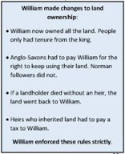
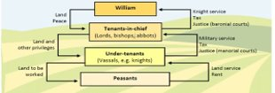
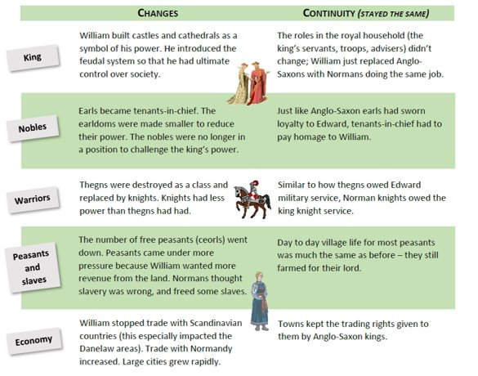

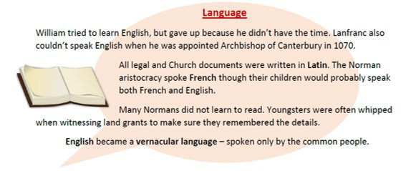
Knowledge Organiser – Normans, c.1066-1100. Part 2: Life under the Normans
An overview of what you need to know for Part 2: Life under the Normans Feudalism and government: roles, rights, and responsibilities; landholding and lordship; land distribution; patronage; Anglo-Saxon and Norman government systems; the Anglo-Saxon and Norman aristocracies and societies; military service; justice and the legal system such as ordeals, ‘murdrum’; inheritance; the Domesday Book. Economic and social changes and their consequences: Anglo-Saxon and Norman life, including towns, villages, buildings, work, food, roles and seasonal life; Forest law.
Exam Questions​​
Describe two key features of……(4 marks)
Explain what …. (8 marks)​​
To what extent do you agree with the statement that…..(16 marks)​​
The Feudal System ​​
​The Feudal system was the system of landholding, and the duties and obligations that came with it. ​William gave land to his tenants-in-chief, but they had to provide him troops when needed. Land with this obligation was called a fief (or feud). ​​
Some landholders also had to provide knights. Knight service was for 40 days, and was unpaid – the tenant-in-chief had to provide money, weapons and equipment for them. Essentially, this ensured that William had troops without having to pay for them himself. ​
The king was the most powerful person in the feudal hierarchy, followed by the tenants-in-chief. Vassals were not as powerful, and answered to the tenants-in-chief.
Tenants-in-chief
Tenants-in-chief held their fiefs direct from the king. They were important people like barons, and some were Church leaders (e.g. bishops).
They had several important roles:
Knight service: There were probably around 6000 knights in Norman England. Their job was to guard their lord’s property, help defeat any threats and provide up to 40 days’ knight service when needed. Knights were superior soldiers. They used cavalry charges and couched lances, also the invention of new saddles and stirrups, effectively against their enemies, and were often based in castles. Knights replaced thegns as the under-tenants; the lords of the manor. They dealt with minor court cases in manorial courts.
Landholding: Under William, when a landholder died their heir did not automatically inherit the land. They had to prove their loyalty to William, and pay him to use the land. This payment was called a relief. William could reward loyal followers with low reliefs, or threaten difficult landholders with high reliefs. This was a new system, which even Normans hadn’t had before. It was designed to encourage loyalty to the king and reduce the power of potential challengers.
Homage – Oath of Fealty: Landholders had to carry out a ceremony of homage to William. They promised on the Bible to remain loyal to him, saying “I become your man”. Tenants-in-chief would perform similar ceremonies with their under-tenants.
Labour service: This was the work that peasants did in return for using the land. It involved farm work (e.g. ploughing the lord’s fields) or providing produce.
Forfeiture: Forfeiture was the punishment for breaking the agreement between landholder and tenant. If the land-user didn’t provide the service required of them, they would forfeit their land or pay a fine.
Changes in Landownership, 1066-87 ​​
​​Between 1066-1087, William replaced the Anglo-Saxon landholders with Normans. The rebellions had showed that he could not trust the Anglo-Saxon nobles. ​​By 1087, less than 5% of the land was held by Anglo-Saxon aristocrats. Only two of England’s tenants-in-chief were Anglo-Saxons. (Tenants-in-chief were the large landholders who held their land directly from the king.) ​​
​
How did Anglo-Saxons lose their land? ​
Forfeit - Landowners simply lost their land as a punishment. William took it and gave it to Normans instead. ​
New earldoms - William made new earldoms, e.g. the Marcher earldoms, and gave them to his followers. They were created to defend trouble spots. ​
Land grabs - This way was illegal – Normans either seized land, or took it through corrupt dealings which left Anglo-Saxons with less than before. Norman sheriffs were known for doing this. ​
​
After 1071 William combined blocks of territory to form large blocks, rather than earls having pieces of land all around the country. ​
To what extent was the Norman Feudal System different to the Anglo-Saxon Feudal System?​
Anglo-Saxon Society​ | Norman England Society​
King: ruler of the country.​ Nobles/landowner/Earls: fought in battles for the king and ran the administration.​ Thegns/Bailiffs: Thegns could own land. Bailiffs enforced law and order.​ Peasants: Farmed the land. Couldn't leave the land without permission. Provided military service.​ ​ | King: Ruler of the country. Gifted land to the nobility and church, but kept ownership of it.​ Nobility and Church: Provided money and an army for the king and land to his knights.​ Knights: Provided military protection on demand for his lord and peasants with shelter, protection and some food.​ Peasants: Farmed the land. Couldn't leave the land without permission. Provided military service.​
Similarities:​ king was the ruler + give and take in society. King appointed people to help him rule. Villeins/peasants could not leave the land without the permission of their superior.​ ​ Differences:​ Normans: King owned all land. Land given as a reward e.g. after Hastings and for loyalty. More noblemen/knights for greater control.​ Anglo-Saxons: King gave ownership of land to the thegns, church and nobility through patronage.​
Changes to Society
Although towns became bigger as people were drawn to them for the jobs they could get especially if there was a castle and/or a cathedral there- overall the percentage of the population living in towns stayed the same at about 5-10% as the population generally was growing.

Slide 5
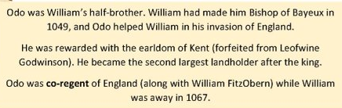
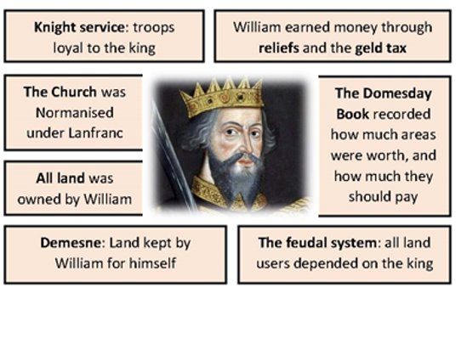
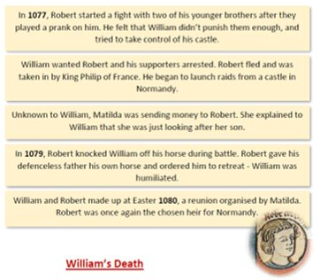
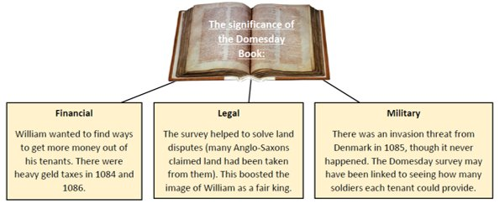
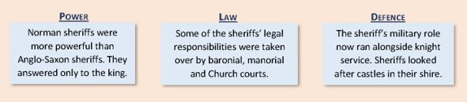
Norman Government ​
​
Changes to Government ​
The existing Anglo-Saxon government was more advanced than government in Normandy, so William kept and improved what worked. ​
William centralised power so that he had total control. He owned all the land and no one was powerful enough to challenge him. ​
The power of the earls was reduced, and some earldoms were phased out completely. He replaced the 6 powerful earls with almost 200 barons who each held less land so had less power so couldn’t threaten him like the Godwin’s had threatened Edward.​
William used regents (e.g. Lanfranc and Bishop Odo) to run either England or Normandy while he was away. He usually returned whenever there were signs of trouble.
Who was Odo?
Odo in trouble: ​
Odo got into trouble with William due to his corrupt behaviour. He seems to have had ambitions for power. ​
The Domesday Book records many complaints against Odo for illegally taking land, including from the Church. Lanfranc complained to William and Odo was made to give land back in 1076. ​
William sent Odo to deal with trouble in Northumberland in 1079. While he was there, Odo damaged the region, robbed people and took cathedral treasures. ​
Odo tried to take some of William’s knights with him on a trip to Rome. This went against William’s power because knights were loyal to the king, not the personal troops of their tenant-in-chief. ​
In 1082, William had Odo put in prison. William was only persuaded to release him on his deathbed in 1087; he had freed other prisoners (e.g. Morcar) with much less persuasion.
William Rufus v. Robert and Odo ​
Lanfranc crowned William Rufus king William II in September 1087. But Odo, recently released from prison, started a rebellion against William II in 1088.​
Odo and many barons thought it made sense for the same person (Robert Curthose) to be in charge of both England and Normandy. ​
Odo was joined by his brother Robert of Mortain (another Robert). ​
Other smaller rebellions also broke out in places such as Norwich, Leicester and the Marcher earldoms. ​
​
However, most of the Norman aristocrats and English population were against the revolt. William Rufus caught both Odo and Robert of Mortain at Pevensey Castle, using local fyrd troops. Odo escaped to Rochester Castle, but eventually surrendered after Robert Curthose didn’t come to support him. ​
Law and Order​
The Normans introduced trial by combat to the British Isles which went alongside the Anglo- Saxon preferred method which was trial by ordeal.​ But, they largely kept the laws that already existed in Anglo-Saxon Britain. ​
The biggest change to the legal system was that the Normans tried to simplify the existing system and apply it evenly throughout England. ​
There were 5 main courts that were used. Clergy however were tried in Bishop’s Courts and usually got less severe punishments. However, sometimes the Bishop’s Court was over-ruled by the secular (non-religious) court on the king’s orders; e.g. Lanfranc and Odo.​
The language of the courts was changed. Norman French was spoken during court hearings, and the records of court cases were written in Latin.​
After gaining control of England using terror William kept control using the following tactics​:
William's relationship with his Son, Robert ​
William’s eldest child was Robert. He was given the mocking nickname Robert Curthose (‘short stockings’/’dumpy legs’), probably by William. ​They had a difficult relationship. William had said that Robert should inherit Normandy, while William Rufus (his favourite son) should inherit England.
Punishments​
Punishment after Trial by Combat or Ordeal was usually execution (unless you had died during the trail) as the outcome showed God’s judgement.​
The death penalty was used more often by William, mostly for serious crimes like murder, rape and treason, and for re-offenders. He also used mutilation as a punishment: loss of fingers, limbs, genitals and/or eyes.​
For more minor crimes, William ordered that fines should be paid as punishment. In the case of physical assault, the criminal still paid a fine, but this went to the king’s officials rather than the victim or his/her family.​
William effectively crushed several rebellions against him, but he was still paranoid about the loyalty of the English with good reason! Murders of Norman nobles and officials became common as they imposed their authority over the Saxons. To stop this, William introduced the Murdrum fine: if a Norman was found murdered, the local area he was found in had to pay a hefty fine.​
The Domesday Book ​
At Christmas 1085, William ordered a survey of England. He wanted to find out who held what land, what taxes they owed and whether they could pay more. ​
The results of the survey were written up in the Domesday Book in 1086.
Who kept Law and Order?​
In Norman England there was no police force. The police as we know it today would not come about until the early 19th century. As a result the law was enforced by a range of people: constables and watchmen and also Anglo Saxon systems like systems like Hue & Cry and Tithing (where 10-12 men were responsible for preventing each other committing crime - if one did they were all punished) that the Normans kept.
Sheriffs: The role of the sheriff (aka shire reeve) stayed mostly the same as in Anglo-Saxon times; William just replaced the Anglo-Saxons with Normans Sheriffs were often unpopular with local people. They were entitled to a share of the revenues they collected from their shire. This meant they could make themselves very rich.
The Domesday Book
​​
What was it?: William sent officials with a survey all over England to assess and value of land and stock and who owned what.​​
Why?: To find out how much people owned so that they could be taxed, in order to pay bribes to the Vikings. Allowed William to raise tax easier, the first written record of the feudal system.​​
Results: William + his family owned 20% of land. 25% owned by the aristocracy. 25% owned by the church. 30% by other Normans.​​
Information collected: Who held/owned land? Wealth e.g. number of animals/ploughs. Population.​
William's Death​
William was injured in July 1087 when he was thrown from his horse during a raid in France. He suffered in pain for weeks before he died on the 9th of September. ​
​People thought his death was full of bad omens: ​
When he died, his panicked servants stole everything they could, leaving his stripped corpse on the floor. ​
At his funeral, his fat corpse burst when it was being squeezed into the tomb. It caused a horrible smell which drove everyone out of the cathedral.

Slide 6
Forest Law​
William liked hunting and kept much more land as royal demesne than Edward had. Demesne was the land that the king kept for his own use. He made new areas into forest – this was not necessarily covered in trees; it meant that it was protected land reserved for hunting. ​Many landholders lost land to forest. Entire areas were turned into forest, such as the New Forest in southern England. ​
​
Reasons why the ‘forest’ was significant: ​
It showed that the power of the king was above everything else. ​
Extending the forest increased the amount of land William controlled directly. ​
Taking areas for forest was basically land-grabbing – William doing this made land-grabbing by sheriffs and barons look more acceptable. ​
There were harsh punishments for breaking forest laws, which showed how brutal Norman rule could be. ​
William earned more money from the forests – from fines and the sale of hunting rights.
Life in Norman villages ​
Peasants: Life didn’t change much. They lived in cottages, grew crops and reared animals. They used a plough pulled by oxen and the main crops grown were wheat, oats, barley and rye.​
Important buildings: The church was at the centre of every village. The church was important because peasants spent most of their free time there as the church was open most of the time for feast days and ‘holy’ days, it signalled the start and finish time at work and it served as a prison. The manor house was where the lord lived and controlled his village from.​
Open field system: A village was surrounded by farmland, the fields were used for grazing cattle and growing crops. These fields were not separated by a hedge, fence or wall. 25-30% of this land was owned by the lord and the rest was given to peasants to farm so that they could pay their rent to the lord.​
Peasants life: Poorest peasants known as villein/serf. Lived around the lord’s manor house. Not allowed to leave without the lord’s permission. Most were farmers, but some were servants or crafts people. Cruck houses (their home) cold + damp as floors were made from mud and walls from clay. Ate, slept + relaxed in a single room, at night would be with their grazing animals. Caused very poor hygiene + health problems.​
Manors: Were areas in a village that included a church, villagers’ houses, manor house, mills, grazing land and a road that ran through them. Lords owned the land + lived in the manor house. Freemen (peasants) lived + worked on this land, paid rent.​
Roles and responsibilities: Reeve was a peasant chosen by the lord or by a vote. Ran the day to day management of a manor, made sure everyone did their job. Bailiff collected taxes + debts. Priest ran the local church. Miller produced grain to make bread.​
The Court System
King’s Court​ The King remained the most important person in the justice system. His decisions were binding. His court dealt with royal pleas which included the most serious offences of murder, treason, arson, robbery and rape. The king could also hear appeals from lower courts. ​
Shire Courts (Honourial courts)​ Introduced by the Norman’s for the lord to deal with his tenants. This kind of court did not only deal with crimes or disputes, they also supervised property transactions or made announcements of new laws from the king. ​
Hundred Courts​ The manor was the area of land controlled by the lord of the manor- usually the same as a village. These courts were the most minor courts that dealt with day to day life in the village, such as ploughing being carried out badly or labour not being supplied. Male villeins would also pay for licences to marry. These courts were controlled by the Lord of the Manor. ​
Lord’s Court​ Established before 1066. Held monthly, with a bailiff in charge (who was appointed by the shire reeve). Some were still held privately, and if so, the Lord would be in charge. For the most part this type of court dealt with minor disputes. ​
Manor Court​ Established well before 1066. They remained largely unchanged but now met much more regularly. They were usually supervised by shire reeve (sheriff) or at times by a Bishop. The judges were local land owners or the Sheriffs. This court largely presided over land or crimes involving violence or theft. ​
Peasant life​
Typical year: 1st rebelled against William – Edwin and Morcar, the submitted to William- William did return their possessions and titles. ​
Food + drink: Day time food include rye bread. Evening meal of own grown vegetables with own grown beer or cider. Meat, sugar and fruit was rarely eaten as it was expensive. Women would work in the home until the last meal was eaten by her family.​
Difficulties: Peasants also had to work for their lord, in times of harvest it was up to 5 days per week- this left little time to harvest their crops for their food and money. Peasants had to pay 10% tax to the church called a tithe. This could also be paid in in seed or equipment. ​
Typical year for a peasant: Spring - Sowing the seeds on their farm. Summer - Harvesting crops. Autumn - Ploughing the field with oxen. Winter – Surviving e,g. living off of food from the harvest.​
Typical day for a peasant: Awake half an hour before sunrise to eat pottage (porridge), when it was light they started working e.g. reaping crops, thatching + threshing. Some peasants were brewers, made beer however, couldn’t sell it until the lord decided on its price. Others were millers, they ground corn into flour, forced to use the lord’s expensive oven to bake bread otherwise fined.
Life in Norman Towns​
​
Growing settlements: London became increasingly important.
21 new towns created around the country, increasing trade. Towns in the south grew as it was important for trade with Normandy..​
Effect of trade on towns: 1 Salt trade important for cooking e.g. town of Droitwich grew due to their 13 salt houses. 2 Metalwork important for building houses + making weapons e.g. Gloucester grew from metalwork because they got their wood from Forest Dean. Wood was need for the furnaces.​
3 Wool trade important for making clothes in England and other countries e.g. wool traded with France for wine. Cities with water links (e.g. on the coast) such as York + Bristol grew as they could 4 trade abroad.
5 Burgesses (powerful town dweller) often goldsmiths or leather workers formed guilds, became powerful people in society.
6 Markets and fairs granted a franchise by the government or monarch e.g. 2,800 grants given by the Normans.
7 Fairs could be sponsored by the church, therefore some fairs were religious gatherings as well as a place to sell goods.​
Things to remember:
England was split into shires, the shire court met twice a year to resolve tax, land and crime disputes put forward by the sheriff.​ Large Anglo-Saxon earldoms were replaced with smaller ones. Castles were built in shires in keep control. The importance of shire courts decreased with the introduction of the honorial court. Juries were now introduced into shire courts.​
Hundred courts​: In Anglo-Saxon England shires were split into ‘100’ hides (approx. 120 acres).​Met more frequently and were run by the sheriff’s deputy.​ Continued to meet and discuss local land issues in each ‘100’.​
Inheritance​: land holding divided amongst families after a death. Given to eldest son – primogeniture.​
Oath system​: Anglo-Saxons had to make an oath of allegiance, ‘the common oath’. Crimes heard by the Hundred courts + punishments could include exile for the criminal + his family.​
Murdrum fines: introduced as an extra punishment; huge fine given to the criminals area for crimes such as the murder or attack of a Norman Earl and later any Norman.​ Family was still punished.​
Language in Law​: Many laws written in English before 1066, After 1066 French and Latin. Laws and church documents in Latin. Latin seen as the language of the powerful.​
Ordeals​: Anglo-Saxons used capital punishment, mutilation + ‘ordeal’ system e.g. ordeal by fire, water or combat.​ Ordeal by fire e.g. criminal would endure a burn and if it started to heal after 3 days they were innocent if not they were guilty. Ordeal by water e.g. would be dunked in water, if they sank they were innocent, if they floated, guilty + then executed.​ Normans introduced ordeal by combat e.g. If a nobleman was accused of a crime he would fight his accuser, who ever won the fight was right, the other person was usually dead.​
Everyday life in Norman England​
Key Areas of Change​:
Land​: Fearful of rebellion William controlled all of the land, giving some to the church and some to Norman earls. Smaller earldoms were set up to help keep control.​
Minting system: creating money).
Exchequer (where the King’s money was kept) was introduced.
Trial by jury and trial by combat.
Peasants could no longer hunt for food if their supplies were low. Peasants could face fines, imprisonment or death.
Murdrum fines: ensured no peasant dared rebel.​
Castles: Nobles built castles to protect themselves, peasants intimidated by them. Some peasants lived and worked within the bailey of the castle so they were protected.​
Language​: Latin – spoken by the nobility (rich), English spoken by peasants. Norman words crept into England e.g. Baron and knife. ​

Slide 7
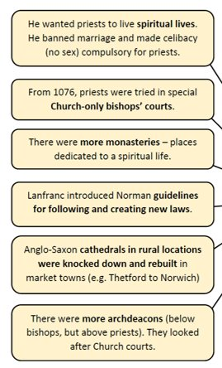
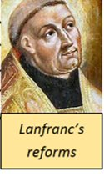
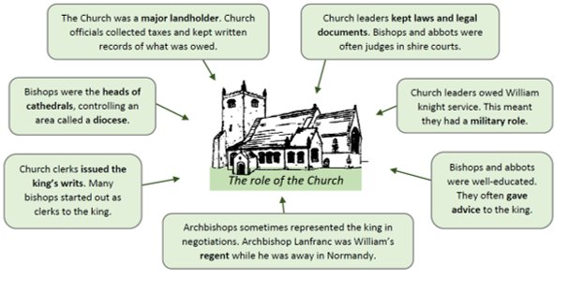
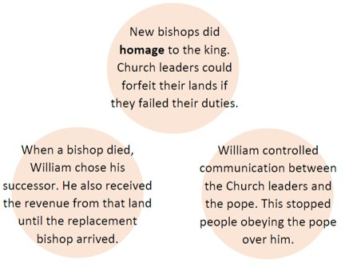
Knowledge Organiser – Normans, c.1066-1100. Part 3: The Norman Church and Monasticism
An overview of what you need to know for Part 3: The Norman Church and Monasticism The Church: the Anglo-Saxon Church before 1066; Archbishop Lanfranc and reform of the English Church, including the building of churches and cathedrals; Church organisation and courts; Church-state relations; William II and the Church; the wealth of the Church; relations with the Papacy; the Investiture Controversy. Monasticism: the Norman reforms, including the building of abbeys and monasteries; monastic life; learning; schools and education; Latin usage and the vernacular.
Exam Questions​​
Describe two key features of (4 marks)
Explain why…(12 marks)
To what extent do you agree with the statement that…(16 marks)​​
The Church​
All people in Europe at this time were Catholic and the Head of the Catholic church is the Pope. People in Norman times had strong religious beliefs. Most truly believed that they would go to Heaven or Hell when they died and that the Pope was God’s representative on Earth. The church was also very wealthy and owned a lot of land. This gave the church a lot of power and influence over people’s lives. ​
​
William had a close relationship with Pope Alexander II who was concerned about CORRUPTION within the church in England. ​His concerns were:
Pluralism: many clergy had more than one role (job) ​
Simony: Positions in the church were often sold to the highest bidder​
Nepotism: Positions in the church were given to friends and relatives​
Many clergy were married even though they had taken a vow of Celibacy​
​
The last Anglo-Saxon Archbishop of Canterbury was Stigand. He was replaced in 1070 by the Norman, Lanfranc. Stigand had been a close ally of Harold Godwin but was also a PLURALIST- he was bishop of Canterbury and Winchester so got the land and money from both roles. He was also accused of SIMONY.
Lanfranc’s Reforms ​
Lanfranc was an Italian monk who had run St. Stephen’s monastery in Normandy. He was heavily involved in changes to the Church. ​Within about 50 years, every English church and cathedral had been rebuilt in Norman style. ​Although most priests were still Anglo-Saxons, after 1070 there was only one Anglo-Saxon bishop left (Wulfstan of Worcester). ​
Relationship between Normans and the church​
Norman Kings and the Pope: Pope Alexander II granted William of Normandy the Papal Banner to fight in Hastings. After the battle the Pope ordered William to pay penance for the killing and destruction that happened. William built Battle Abbey which was finished in 1095. William used a geld (form of tax) to take money from the religious house and this was continued by his son. Both William and William II used their power to promote/reward people, but they did not have the power to do so, this led to disagreements between the king and Pope. ​
​
Normans and the wealth of the church: William and William II used the church for their gain (stealing from churches). Example: one monk melted down a chandelier for £40 (£35,000 in today’s money). However, these stories were often written by Anglo Saxon chroniclers.​
​
Anselm: Archbishop Lanfranc died in 1089, William II did not replace him he stole the money from his church and used in battles against King Malcolm of Scotland. William became ill – he believed it was because of his lack of piety so he asked Anselm to hear his confession and take his last rites. Anselm became the new Archbishop of Canterbury for his service. Anselm became the new Archbishop.​
​
1097: Disagreement between William and Anselm over an issue in Wales. Anselm fled to Rome, which showed that he accepted the authority of the Pope rather than the King. ​
​
1078: Pope Gregory banned kings from appointing bishops and abbots, in order to keep their independence. Disagreements between monarchs and Church! ​
This was known as the Investiture Controversy lasted 1075-1122.
Normanisation
The Church was “Normanised”: ​
Norman bishops and archdeacons influenced the messages people heard about the king and God. ​
A quarter of all land was held by the Church. Putting Normans as bishops and archdeacons reduced the risk of Anglo-Saxon rebellions.
Parish priests came under stricter control. They had to follow Norman procedures.
Role of the Church​
The Normans were Catholic and believed in heaven and hell. The Church was led by the Pope in Rome.​ People learnt about heaven and hell through church paintings that William introduced because peasants couldn’t read. The church collected tithes, were the only ones who could educate, made up the witan and were very powerful.​ Priests were very important; they helped the sick and gave advice.​People went on a pilgrimage if they had sinned (illness also caused by sinning) – a walk to a holy place - to say sorry to God.​
WILLIAM’S CHANGE TO THE CHURCH​
Bishops were replaced with Normans.​
Normans stole wealth from places such as Durham.​
Organisation: Dioceses (areas of land served by the church were divided into archdeaconries. New cathedrals were built in new towns like Lincoln and Coventry​
Followed papal law - pay 1p tax to the Pope.​
CHANGES HELPED WILLIAM CONTROL – PEOPLE WERE SCARED TO GO AGAINST THE CHURCH (grand, expensive buildings) IN CASE THEY WENT TO HELL!​
Normanisation strengthened William’s power in 3 ways​

Slide 8
Relations with Papacy and the Investiture Controversy
William I
William had a good relationship with the Pope.
The Pope had blessed the invasion of England and given him the papal banner.
William had a strong religious belief
William and Lanfranc’s Reforms helped stem the corruption in the church
William Rufus
William Rufus’ relationship with the Pope was more problematic
William Rufus did not share his father’s religious beliefs. He was seen as immoral, hadn’t married or had children and was probably homosexual, which the church did not like at that time.
When Lanfranc died he didn’t replace him so that he could keep the archbishop’s land for himself
After an illness thinking God is punishing him he tried to appoint ANSELM as a new Archbishop who refused the post
Anselm accepted the position as long as William Rufus accepted the authority of the Pope (which he agreed to) and gave the land back (which he refused).
Anselm accepted the position but soon they argued as William Rufus stopped Anselm from travelling to Rome to get PALLIUM- (the Pope’s approval for his appointment as Archbishop). William wanted to limit the Pope’s influence. A Council was called to debate the matter (The Council of Rockingham) in 1095.
At the Council of Rockingham a truce was declared and William Rufus sent a messenger to ask for Anselm’s PALLIUM from the Pope. The King had been forced to accept the authority of the Pope but the Pope agreed to stay out of English affairs.
William Rufus blocked Anselm’s attempts to carry out church reforms. Anselm was reluctant to pay Rufus extra taxes or provide him with the Knights the King required.
In 1097 relations between the King and Anselm reached an all-time low and Anselm was exiled and fled to Rome. William Rufus was able to profit from the empty position in the church once again.
William Rufus reintroduced the practice of SIMONY (selling positions in the church). William made one of his key allies Ranulf Flambard Bishop of Durham in return for £1000. Flambard was unpopular with the church but good at raising taxes.
Henry I & The Investiture Controversy
When Henry became King in 1100 Anselm (who had returned from exile) refused to pay homage (the oath of fealty) or be invested by the King. The church was against this as it seemed to show that the King was in charge of spiritual matters not the Pope.
Anselm was sent in exile once again and Henry was threatened with excommunication.
In 1107 Henry and the pope reached an agreement called the CONCORDANT OF LONDON. Henry agreed to give up his right to invest new bishops but they would still pay homage to him.
Anselm returned and SIMONY was outlawed once again, marriage for the clergy was banned once and for all and church positions were filled immediately unlike in William Rufus’ time.
Norman churches and abbeys​
Monastery: Religious house where Monks live and work. Known as abbeys in the 11th century. Monks and Nuns dedicated their life to God. Took vows of poverty (gave up possessions), chastity (not get married and remain celibate), obedience (obey their abbot or prior and obey all rules of monastery). ​
Norman revival: Pre-Normans- Vikings reduced the power of the church- 1066-1135: number of monks/nuns rose from 1000 to 4000-5000. Religious houses increased from 60 to over 250. In 1066 4 cathedrals had monasteries, by 1135 10 of England’s 19 had a monastery. William paid for the building of Battle Abbey to commemorate his victory at Hastings. ​
Cluniac Monasteries: Cluny Abbey established 910 by William of Aquitaine, French monastery but was given its own identity. Permanent freedom from military services and other feudal duties. The Cluny only answered to the Pope. New tradition: all monasteries answered to the Abbot of Cluny. Annual meeting to deal with any issues. ​
English Cluniac: 1077 by William de Warenne. 1135 there were 24 Cluniac monasteries in England. These were the spiritual arm of the military conquest. New religious houses were often built next to castles, to demonstrate that the Norman domination of England had the blessing of God. ​
Leadership: Gradually changed from Anglo-Saxon to Normans. 1075 – Lanfranc held a council in London, 13/21 abbots were Anglo-Saxon, by 1086 3/21 were. ​
Reforms: 1077 – new set of constitutions at Christ Church, Canterbury. Reformed: Liturgy (words at the service) , set up church hierarchy and set out rules for life in the monastery. These were followed at monasteries such as Durham and Rochester. Lan Franc (Archbishop) tried to make abbeys like the rest of Europe.
Monasticism and Reforms:
Between 1066 and 1135 the number of monks and nuns increased from about 1000 to about 5000.​
The number of monasteries grew from 60 before the Norman Conquest to about 250 by 1135​
In 1066 there were 4 cathedrals that had monasteries attached to them. By 1135 10 of England's 19 cathedrals had monasteries attached to them​.
Before the Conquest, the Rule of Saint Benedict provided the model for all English monasteries, but after 1066 new orders entered England although most monasteries were still Benedictine.​
The Cluniac order was introduced into England in 1077. It had twenty-four monasteries by 1135. They were often built next to castles. At Cluniac monasteries the rules of St Benedict was imposed more rigidly. ​
In 1077 Archbishop Lanfranc introduced a new set of CONSTITUTIONS at Christ Church in Canterbury. These were then to extend to other monasteries. He reformed the LITURGY (the church service) making it more like the church services in the rest of Europe. As part of his reforms Lanfranc made strict rules about the creation of saints and laid out a structure for domestic life in the monastery. Lanfranc basically wanted monasteries to stick to the Rule of St Benedict so it was only monasteries that had been breaking the rules that would see a great change.​
In 1070 two Anglo Saxon abbots were removed from their posts and replaced by Norman ones.​
By 1075 only 13 out of the 21 abbots were Anglo Saxon.​
By 1086 only three Anglo Saxon abbots remained.​
Why were monasteries important?​
They educated the sons of the nobility - teaching Latin, music and verse, astronomy and maths. ​
They recorded and wrote the history of the time (e.g. Orderic Vitalis)​.
They had infirmaries (hospitals) where monks cared for the sick​.
They looked after the poor and gave food to those who needed it (ALMONY)​.
They provided accommodation for pilgrims​.
They built up libraries of important manuscripts​.
All books had to be handwritten. Monks copied books in a room called a scriptorium. It could take a scribe up to 18 months to write out a new Bible. ​
Latin (language of the church) now became the language of the government too. English was no longer used in written works apart from the Anglo-Saxon chronicle which ended in 1154.
Why did William build Cathedrals?
William embarked on a cathedral building program and all the Anglo Saxon cathedrals were destroyed and replaced. Durham Cathedral is a good example of how William kept control, the reforms that Lanfranc made and the conflict within the church. Cathedrals were a symbolic reminder of: that God favoured the Normans, Norman power and prestige and The Norman conquest
William needed to take control of England
William built grand, stone, cathedrals in the Romanesque style as SYMBOLIC representations of his power.
William built cathedrals near large populations as a STRATEGIC way of keeping power.
William and Lanfranc replaced Anglo Saxon bishops with Normans and reorganised the hierarchy of the church to ensure loyalty.
BUT…. The church still held onto much power and was very wealthy.
William & Lanfranc’s reforms
William and Lanfranc made sure that the vow of celibacy was kept by the clergy
William and Lanfranc introduced Bishop’s Courts to try the clergy
In 1077 reformed the LITURGY (the church service) making it more like the church services in the rest of Europe.
Lanfranc introduced a more disciplined code of conduct for the Benedictine monks and linked many orders to cathedrals.
Other orders began to establish monasteries (eg Cluniac).
Benedictine monasteries promoted learning and also had a high devotion to saints.
Conflict
Relations between church and the king wasn’t always positive. William Rufus was particularly unpopular with the church. They though he was homosexual and he thought the church had too much power.
William Rufus continued to come into conflict with the next Archbishop of Canterbury Anselm. William Rufus reintroduces the practice of SIMONY (selling key positions in the church).
Cathedrals: Seen as a dedication to God in stone, they were seen from miles around with high ceilings, clean lines and symmetrical columns. ​Very different to the smaller Anglo-Saxon churches. Used as a form of intimidation, similar to Castles. Often built on top of a hill (eg Durham Cathedral.) Designed to show the strength of the Norman faith. Cathedrals were built in a cross to symbolise the crucifixion of Jesus and most monks lived inside. Attracted pilgrimages and contained shrines/holy relics.​
Pope: Head of Catholic Church
Abbot: Head of the monastery, often be a noble who had not inherited land.
Prior: Run the monastery when the abbot was away
Obedientaries: Senior monks; Cellarer (looked after food produced by the monastery), Infirmerer (looked after sick monks), Guestmaker (looked after pilgrims/travellers), Sacrist (in charge of all arrangements for the church) Almoner (gave alms to poor)
Monks: Full members of the community who had taken a vow
Novice: Monk/nun who had not taken vow, overseen by Novice Master (another obedientary)
Pope
Abbott
Prior
Monks /Nuns
Obedientaries
Novices

