Slide 1
America, 1840-1895
Session 5: Impact of the American Civil War, 1861-65

Slide 2
America, 1840-1895 – Course Content​
Part one: Expansion: opportunities and challenges ​
The geography of North America: attitudes to the Great American Desert; the belief in ‘Manifest Destiny’.​
Why the early settlers went west and the challenges they faced: Brigham Young and the Mormons; the pioneer migrant farmers, the journey west; the miners.​
Dealing with a different culture: the Plains Indians’ way of life; early American Government policy towards the Plains Indians; the Permanent Indian Frontier; a changing relationship with the Plains Indians.​
Part two: Conflict across America ​
Increasing conflict on the Plains: the Fort Laramie Treaty (1851) and the failure of the policy of concentration; the Indian Wars (1862–1867): reasons for and consequences of the Wars; Sand Creek Massacre; Fetterman's Trap.​
The background to the American Civil War: differences between North and South, issues of slavery, westward expansion and free states abolitionism; breakdown of the Missouri Compromise, John Brown, the roles of Lincoln and Jefferson Davis; the social and economic impact of the American Civil War on civilian populations. ​
Coming to terms with the Mormons: the Mountain Meadow Massacre and its aftermath.​
Part three: Consolidation: forging the nation ​
The aftermath of the American Civil War: the 13th Amendment; Civil Rights Act; reconstruction in the South, 1866–1877; carpetbaggers; the balance of Federal and State powers. ​
The continued settlement of the west: the Homesteaders, reasons for going west; government actions and laws; land and railroads; farming problems and solutions. ​
The resolution of ‘the Indian problem’ after 1865: the small reservations policy; attitudes to the native Americans; Battle of the Little Big Horn; The Dawes Act; Battle of Wounded Knee; the closing of the frontier and its impact on native Americans.​

Slide 3
An outline of the overall social and economic effects of the Civil War on the civilian population on the Homefront.
1. Recruitment and Conscription
5. Social Impact
Impact of the American Civil War on the Homefront
4. Economic Impact in the South
2. Emancipation (Freedom)
3. Economic impact in the North
It's important to remember that the Civil War had a huge impact on the lives of civilians – things were especially tough for southerners.

Slide 4
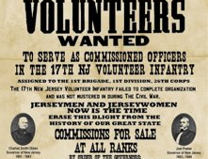
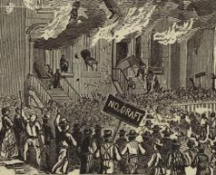
1. Recruitment and Conscription
At the start of the Civil War volunteers rushed to join the armies
of both sides. Local recruiting offices were set up and volunteer
regiments tended to be composed of men from a particular
area. Initially officers up to the rank of colonel were elected by
other officers and enlisted men, and uniforms varied between units.
People expected a short war but it quickly became apparent that
that would not be the case and soon the volunteers were not enough.
The Confederacy introduced CONSCRIPTION first in April 1862. All able-bodied men between 18 and 35 were required to serve for three years. By the end of the war this had been extended to all men between the ages of 17 and 50. The Union introduced conscription in March 1863 for all able-bodied men between the ages of 20 and 45. In the South there were exemptions for planters with 20 or more slaves. In both North and South those unwilling to fight could provide a substitute not of draft age or pay a fee $300 or $500, respectively. There was widespread opposition to conscription in both the North and South, which limited its enforcement.
Notes:
Information from p. 26-27 of the Green Textbook

Slide 5
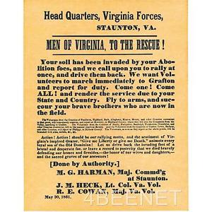
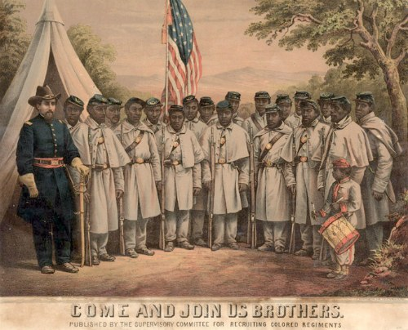
Look carefully at these sources. They tell you something about Recruitment in both the North and South.
Which cause of the Civil War can you see evidence of in both sources?
In what different ways do the posters try to persuade men to enlist?

Slide 6
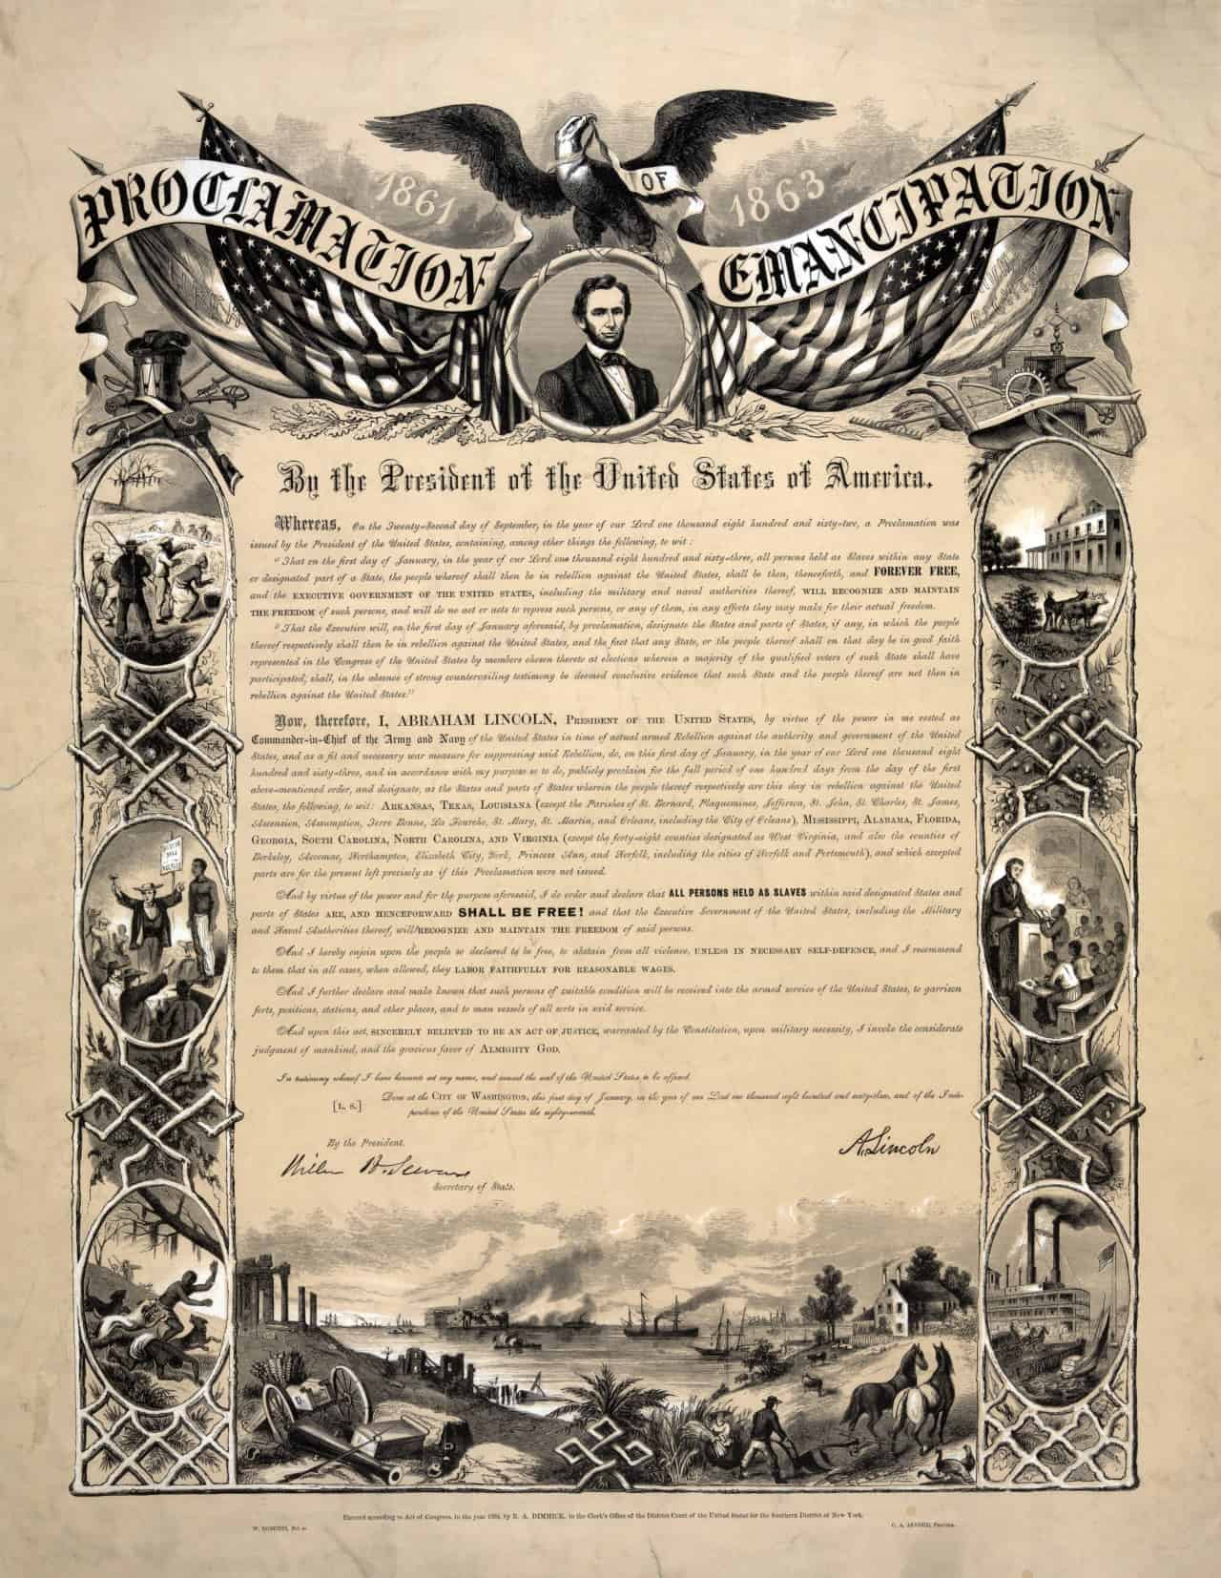
2. Emancipation (freedom)
Lincoln was clear that the Civil War was about reuniting and restoring the Union, and not about freeing the slaves and ending slavery. However, on 1 January 1863 he signed the Emancipation Proclamation. This was a key moment. Up to then Lincoln had insisted that the war was to restore the Union and not to free the slaves, but growing numbers of slaves began to turn up in Union army camps. The question then was should they be freed. In the end Lincoln decided that emancipation was necessary for three reasons:
It would give the North a moral cause, public opinion was moving in that direction already and he felt this would boost morale.
Slave labour was propping up the Confederate war effort with slaves working in MUNITIONS works and army camps.
Making the war into one against slavery would remove any danger of France or Britain supporting the Confederacy.

Slide 7
Impact of the Emancipation Proclamation...
Interesting Fact:
Both Confederate and Union armies frequently organised units along community and ethnic lines. The Union army had French, German, Irish, Scandinavian and Scottish Highlander units. The Confederate army had German, Mexican–Texan and Creek and
Cherokee nation units. Towards the very end of the war the Confederacy was so desperate for men that it passed a law
allowing the arming of 300,000 slave soldiers, although this was too late for any plan to be put into action.
One immediate effect of emancipation was that African Americans could enrol in the armed forces. Moves were made to form all-black units and by mid-1863 they were involved in the fighting. They did not always receive equal treatment and there were no black officers. Initially black soldiers received lower pay than white soldiers, but this was changed in June 1864. When some were captured by the Confederates they were not treated as prisoners of war but were returned to slavery in the state they came from or in some instances executed. Over 38,000 had died by the war’s end.

Slide 8
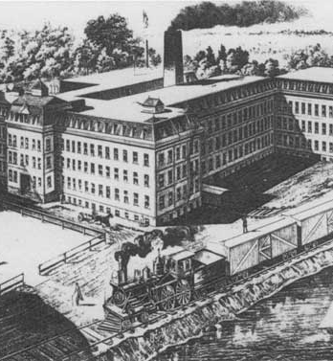
3. Economic impact of the Civil War in the North
As the pre-war economies of North and South were complementary the war was inevitably going to damage some industries. The Northern shoe industry lost a big part of its market which was in the South. It was noticeable that the Confederate army was never short of munitions but was short of boots for its men! The cotton textile industry lost access to its raw materials – Southern cotton. Other industries directly related to the war flourished, such as the manufacture of arms and uniforms and the railroads that moved men and munitions.
It was the wealthy manufacturers and traders who tended to profit most from the war. Ordinary workers found their wages lagging behind prices as wartime taxes and INFLATION pushed them up. This was made worse by the presence in the workplace of women and boys replacing men. They were happy to accept lower wages as this represented an improvement for them. When workers pushed for wage increases they were accused of being unpatriotic and in 1864 troops were diverted from the battlefield to put down protests in war industries.​
By the end of the war the industries of the North were ready for rapid growth.​

Slide 9
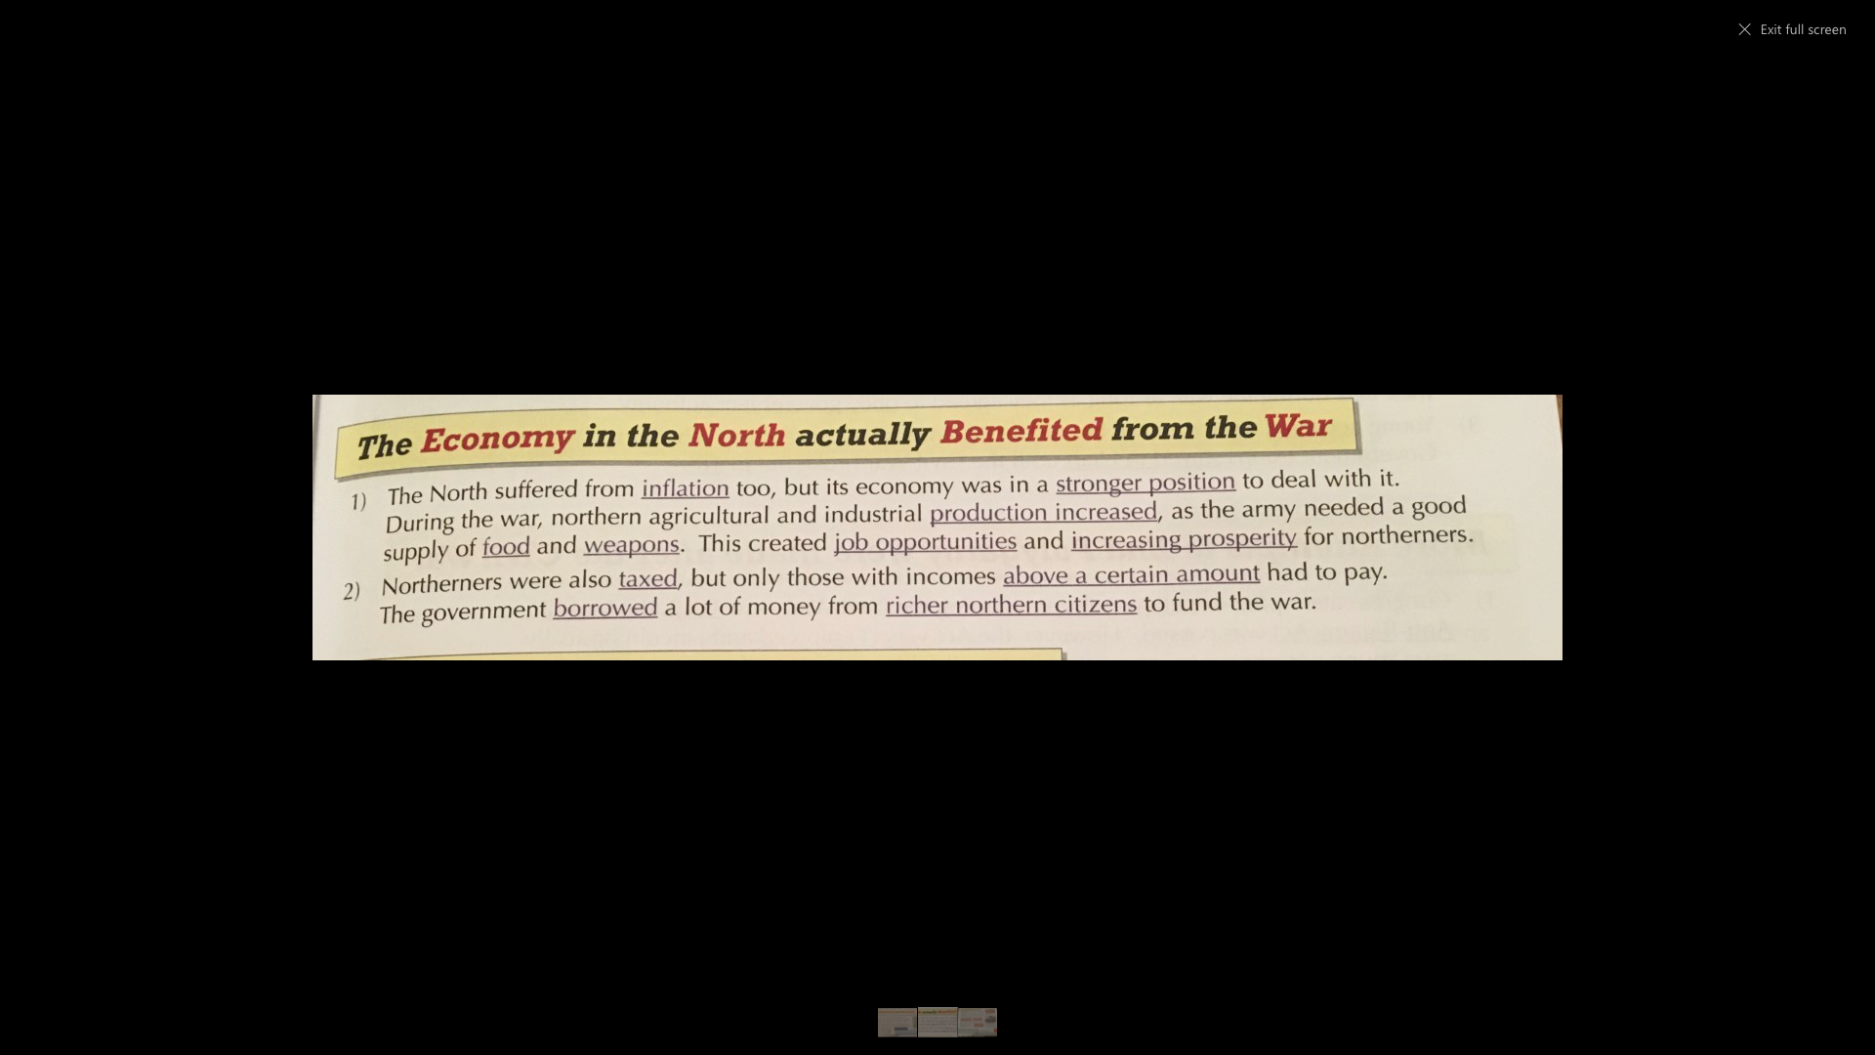

Slide 10
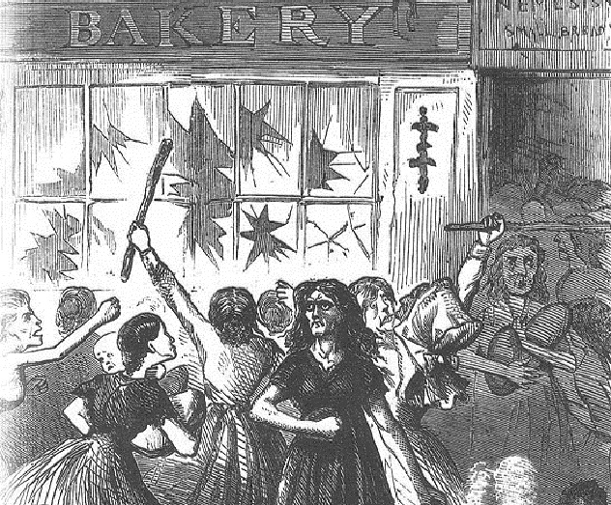
Inflation leading to Hyperinflation
Rising inflation in the Confederacy.
1861 - 12%
1862 - 70%
1863 - 190%
1864 - 250%
1865 - 500%
Trade of food between North and South
How did the civil war damage the Southern economy?
Railroads
Food shortages / riots
Cotton growing
Growth of some industries

Slide 11
If the effect of the war in the North was mixed, it was an economic disaster in the South. The war destroyed the railroad system as Union troops tore up tracks, bent rails and burnt rolling stock. Cotton growing was badly disrupted by the Union advances. Production fell from 4 million bales in 1861 to 300,000 bales in 1865. The only industries to grow were those associated with the war effort, such as munitions. Food shortages became a major problem in the South towards the end of the war as agricultural crop yields fell due to manpower shortages, as the men were in the army. But there were food riots in some cities as early as 1863. Meanwhile, some plantation owners continued to grow cotton in search of profits rather than listening to their government’s appeals to grow food. In one respect cotton growers did help the South. They were cut off from Britain and their European markets by the Union naval BLOCKADE but they were able to trade for food with the North, which was itself desperate for supplies for its cotton industry. So even during the fighting there was some trade across the lines.
The South also suffered from terrible inflation. The Confederate government at first tried to fund the war through new taxes but was so unsuccessful in collecting them that it resorted to printing more money. This led to HYPERINFLATION and the more money the government printed the worse it became.

Slide 12
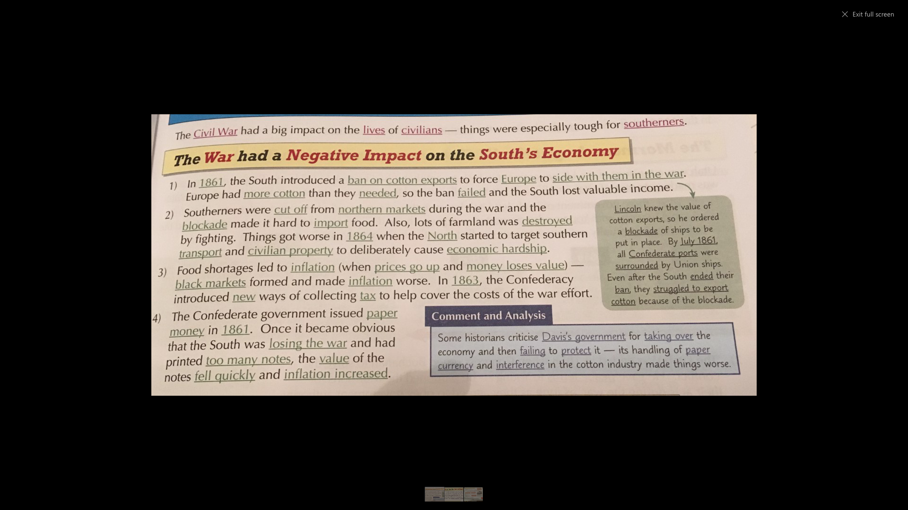

Slide 13
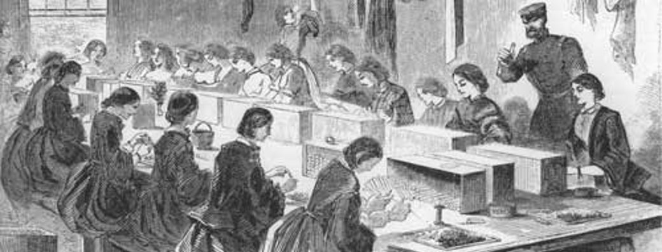
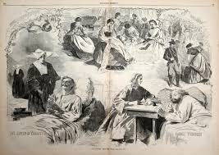
5. Social Impact on Women
During the war, as men went off to fight, many women volunteered as unpaid nurses while thousands took on new roles as farmers, plantation managers and munitions-plant workers. While many returned to their traditional roles when the war ended, the experience had changed the status of women. Moreover the high numbers of casualties created a generation of widows, spinsters and wives of disabled husbands. Immediately after the war, however, an appeal for the vote for women as well as for black males received little support.

Slide 14
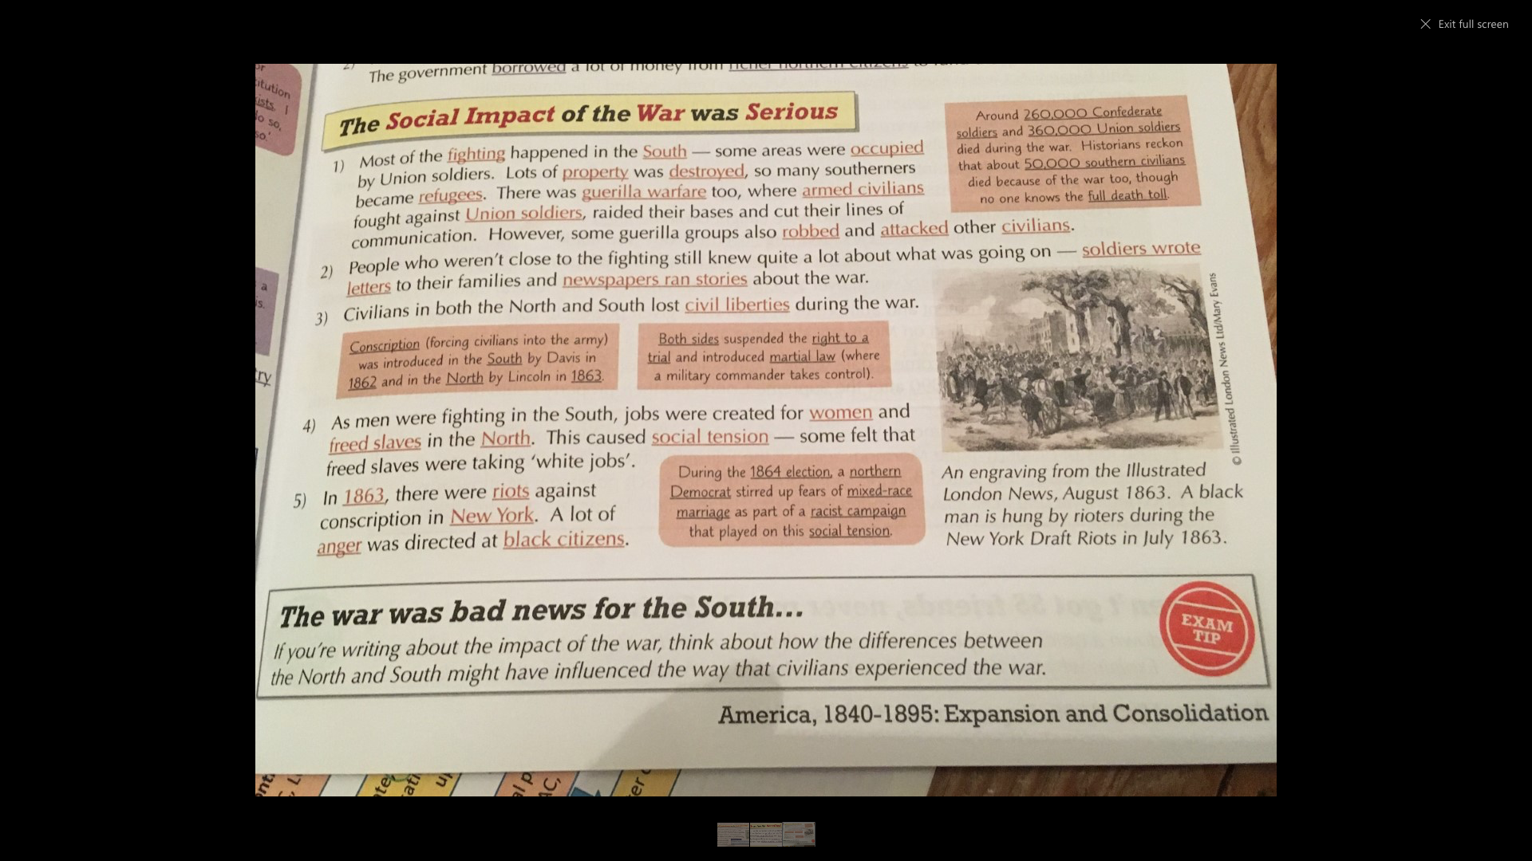

Slide 15
Question 5:
In what ways was the Government important to the successful settlement of the whites on the Great Plains from 1862?
(8 marks)
Exam Practice
How would you answer this question?
Paragraph 1:
First killer point
Paragraph 2:
Second killer point

Slide 16
What mark would you give this answer?
In what ways was the Government important to the successful settlement of the whites on the Great Plains from 1862?
One way that the Government was important to the success of settling on the Plains was the land acts which were passed to support families migrating West. The US Government realised that they needed to populate the West and to help with this the Homestead Act was passed in 1862. It promised families 160 acres of land for free, provided they cultivated the land. In 1875 the Government enacted the Timber Culture Act which gave settlers a further 160 acres of free land provided they planted 40 acres with trees. This helped with the success because it made sure areas of land were being cultivated to provide wood which would help with building materials.
Level 1 – Identify or describe one reason why it was important (1 – 2 marks)
Level 2 – Simple reasoning to briefly explain why it was important (3 – 4 marks)
Level 3 – Reasoned explanation of 2 or more reasons why it was important (5 – 6 marks)
Level 4 – Complex explanation of importance with specific details and evaluation of the impact of the change (7-8 marks)
Notes:
Print off

Slide 17
2nd point: Your turn…
5m
Level 1 – Identify or describe one reason why it was important (1 – 2 marks)
Level 2 – Simple reasoning to briefly explain why it was important (3 – 4 marks)
Level 3 – Reasoned explanation of 2 or more reasons why it was important (5 – 6 marks)
Level 4 – Complex explanation of importance with specific details and evaluation of the impact of the change
(7-8 marks)
EXPLAIN why the government building of the transcontinental railroad was important to the successful settlement of the whites.
TIP: Lots of people describe a change, but do not explain the effect of this. This is a cause and consequence question… This happened and it led to… BECAUSE…

Slide 18

Code this
1. Make your POINT CLEAR!
2. Address key dates!
Another way that the Government was important for the successful settlement of the whites on the Plains was by enacting the Pacific Railroad Act in 1862. This was the first Transcontinental Railroad which ran across the US from East to West. Before the building of the railroads, settlers struggled with the crossing of the Great Plains. They had to adapt to the extremes in weather, lack of resources and the hardships of the natural boundaries of the Plains. In addition, land either side of the railroads was sold cheaply to the settlers which would have benefitted them financially. People and important supplies such as building materials and machinery could now be transported with ease across the plains.
3. Show you understand the impact of the change!
4. Add contextual knowledge!

