Slide 1
America, 1840-1895
Do Now:
Using the 'content overview' sheet, RAG rate each section. Red = not a clue, Amber = bit shaky, Green = absolutely fine

Slide 2
Paper 1 Section A: America, 1840-1895
Course Content:
Part 1 – Expansion, Opportunities and Challenges
Part 2 – Conflict across America
Part 3 – Consolidation: Forging a Nation

Slide 3
America, 1840-1895 – Course Content​
Part one: Expansion: opportunities and challenges ​
The geography of North America: attitudes to the Great American Desert; the belief in ‘Manifest Destiny’.​
Why the early settlers went west and the challenges they faced: Brigham Young and the Mormons; the pioneer migrant farmers, the journey west; the miners.​
Dealing with a different culture: the Plains Indians’ way of life; early American Government policy towards the Plains Indians; the Permanent Indian Frontier; a changing relationship with the Plains Indians.​
Part two: Conflict across America ​
Increasing conflict on the Plains: the Fort Laramie Treaty (1851) and the failure of the policy of concentration; the Indian Wars (1862–1867): reasons for and consequences of the Wars; Sand Creek Massacre; Fetterman's Trap.​
The background to the American Civil War: differences between North and South, issues of slavery, westward expansion and free states abolitionism; breakdown of the Missouri Compromise, John Brown, the roles of Lincoln and Jefferson Davis; the social and economic impact of the American Civil War on civilian populations. ​
Coming to terms with the Mormons: the Mountain Meadow Massacre and its aftermath.​
Part three: Consolidation: forging the nation ​
The aftermath of the American Civil War: the 13th Amendment; Civil Rights Act; reconstruction in the South, 1866–1877; carpetbaggers; the balance of Federal and State powers. ​
The continued settlement of the west: the Homesteaders, reasons for going west; government actions and laws; land and railroads; farming problems and solutions. ​
The resolution of ‘the Indian problem’ after 1865: the small reservations policy; attitudes to the native Americans; Battle of the Little Big Horn; The Dawes Act; Battle of Wounded Knee; the closing of the frontier and its impact on native Americans.​

Slide 4
Revising Content:
Using your Knowledge Organisers and the additional Revision Booklet, start revising all of the sections you coded RED = not a clue!
The best way to do this is:
Pick a small section.
Read it carefully – try to memorise it.
Now self-quiz – can you remember it? If not, try again.
Extend your understanding:
Where and how does this information fit in with the course?
Do you understand it? If not, ask me to explain.

Slide 5

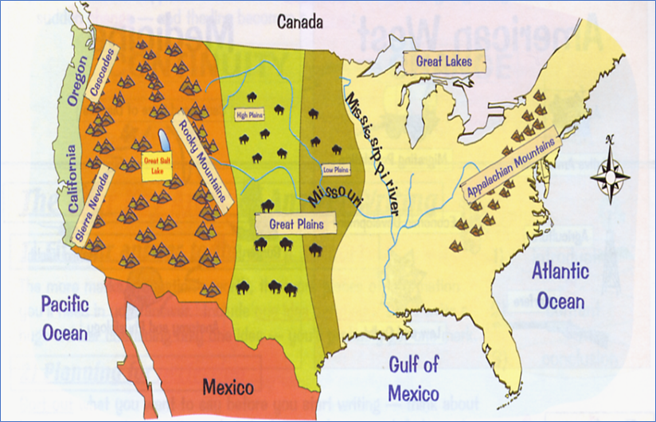
Part 1: Expansion, Opportunities and Challenges
Geography and Climate
Manifest Destiny
Early Pioneer Farmers
Mormons
49ers

Slide 6
Revision Session 1:
Manifest Destiny and Early Pioneers (Mormons, Pioneer Farmers and 49rs) - push and pull factors, hardships faced and how they overcame them

Slide 7
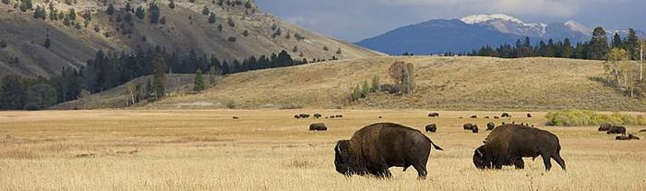
Geography and Climate
Central North America was dominated by the Great Plains
This was mostly a huge, flat expanse of grassland.
It became drier and more desert-like the further south you went.
The weather on the Plains varied hugely - the mountains either side produced rain shadows, which meant little rainfall. Droughts were common in summer and severe snow in winter. Being so far from the sea meant there was aa huge difference in temperature between summer and winter.
US Citizens called the Plains 'The Great American Desert' in 1830. Why?
Unfit for cultivating crops
Uninhabitable for a people who depended on agriculture
Lack of wood and water an obstacle
Wild and harsh
Extremes of weather, sparse rainfall and hard ground
Indians!
Wild animals

Slide 8
Why did people go west in large numbers from the 1840s?
Problems in the East (PUSH FACTORS):
Economic Problems – recession in 1837 caused banks to collapse and businesses fail. Wages fell and unemployment rose.
Overpopulation - high levels of European immigration led to overcrowded cities, fewer jobs and lack of land to farm.
Disease –overcrowding and poor sanitary conditions led to epidemics of yellow fever and cholera.
Attraction of the West (PULL FACTORS):
It offered a new start – the land was fertile and cheap.
Government Encouragement – the government passed acts which allowed settlers to claim land in Oregon (they wanted people to settle in the West to strengthen their claim to the land there).
Gold - found in 1848 at John Sutter's sawmill in California. By 1849 there was a gold rush. Tens of thousands of people journeyed west hoping to make their fortune.

Slide 9
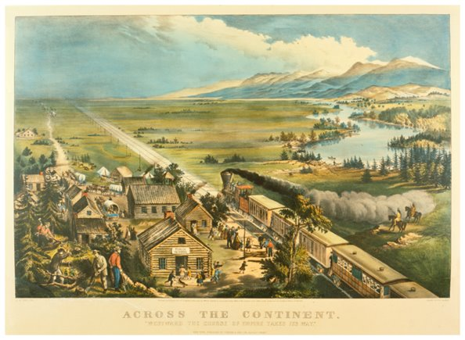
Paintings which created a romantic, idealised image of moving west promoted expansion. For many, the journey wouldn’t have been as pleasant as this image suggests.
Settlers also moved because of
'Manifest Destiny'
Us citizens believed they were destined to occupy and govern all of North America. They saw it as their god-given right. They believed that they were superior to the Native American Indians and that they should civilise the continent.
The term was coined by John L O'Sullivan in 1845.

Slide 10
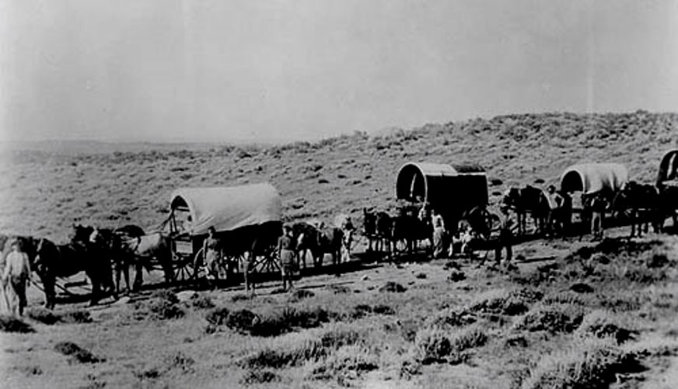
The journey west was a difficult one. Why?
It took around 5 months to complete the 2000 mile overland journey. The journey had to be completed before winter. People travelled in wagons and formed wagon trains with other settlers.
The journey was dangerous – as many as 10% would die on the way.
    There were mountains and rivers to cross, which was difficult in heavy wagons
    People suffered from food and water shortages, and diseases such as typhoid and cholera.
    Accidents were common, such as falling under wagon wheels and accidental shootings.
Travellers were wary of the Plains Indians – some killings did occur, but conflict was rare. Indians traded food with travellers and offered them guiding services, but they became more hostile with the rise in number of settlers in the 1850s. Travellers also had disputes amongst themselves.
Women did all of the domestic chores, and this was made harder on the trail. Some women had to give birth on the journey, while children were vulnerable to accidents, e.g. falling off wagons.

Slide 11
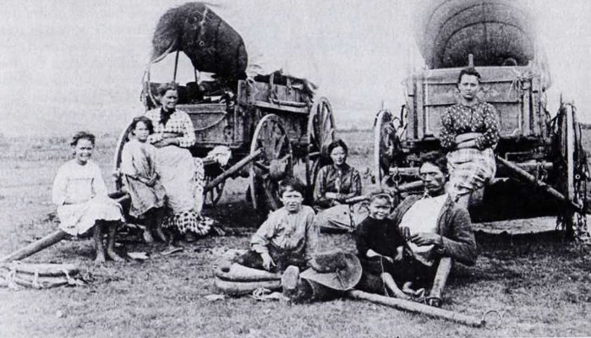
A Case Study: The Donner Party
The Donner Party had a disastrous journey. Why?
In 1846, heading to California, they tried to take a
shortcut, but they ended up trapped in the deep snow
in the Sierra Nevada mountains.
They had to camp in the mountains over winter. Supplies were low and many of the party starved to death.
They had to kill and eat the animals which pulled their wagons because they ran out of food.
Of the 87 migrants, less than 50 survived till the next spring – by eating those who had died!
Don't forget!
Once the settlers had reached the west coast, life was still hard – they ahd create farms and homes bu hand from scratch. However, the fertile land meant a good living could be made.

Slide 12
The Mormons
Many US citizens disliked the Mormons, and repeatedly drove them out of their homes. They didn’t agree with the Mormon practice of polygamy (having more than one wife), feared the expansion of the Mormon faith and felt threatened by the Mormons political and economic power.
Why did they move west?
Persecution in the East!
This religion was started by Joseph Smith, who published the Book of Mormon in 1830. It claimed that Jesus had visited America and that the Native Americans were descended from the lost tribes of Israel.
Mormons separated themselves from American society and called non-Mormons 'gentiles'
Some Mormons formed a militia called the 'Danites', and there was violence against gentiles and dissenters (Mormons who questioned or abandoned the faith)
Mormons were against slavery and they also tried to convert the Native Americans to Mormonism.
Ohio, 1831
The Mormons first settled in Kirtland, Ohio. They faced violence Joseph Smith was tarred and feathered in 1832. The bank that Smith founded collapsed in 1837 – users of the bank were angry and drove the Mormons to Missouri.
Missouri, 1837
The Mormons' anti-slavery stance annoyed slave-owners, and the Danites were suspected of plotting with the Native Americans. Many leaders were arrested, so Brigham Young led the Mormons to Illinois.
Illinois, 1839
The Mormons created their own city called Nauvoo, with its own army and laws. Joseph Smith declared his candidacy for President. Smith was eventually killed in jail by an angry mob and Brigham Young took over as leader.

Slide 13
Smith founded a bank which collapsed causing debts for many non-Mormons
Non-Mormons were afraid of the Mormon secret army known as the ‘Danites’
Joseph Smith ran for President of the USA. People feared that this would give the Mormons more power
The Mormons worked hard and became prosperous. Poorer non Mormons were jealous
The Mormons accused their non-Mormon neighbours of theft, racing & gambling.
Why were
the Mormons
so unpopular
in the East?
Non-Mormons were afraid of Mormon sympathy for the Indians
Mormon leaders had religious and political power which was feared by the non-Mormons
Mormons opposed slavery but many of their neighbours had slaves
The Mormons practised polygamy & non-Mormons hated this
The Mormons wanted to convert as many people as possible to the Mormon Church. This worried non-Mormons who feared being taken over
The Mormons wanted their own laws which made them appear different

Slide 14
Mormons moved west and settled in the Salt Lake Valley
The Journey west:
They had planned to leave Illinois in Spring of 1846, but due to increased anti-Mormon violence that left in February. This rushed departure meant that they left supplies behind and were disorganised. Conditions were hard – it was a cold winter and there was deep mud.
Their progress was very slow, which meant they couldn't complete the journey that year. They stayed in Winter Quarters by the Missouri River over winter – by Spring of 1847, around 400 Mormons had died from disease, the cold and lack of supplies.
They set off again in April 1847 and organisation improved. They were divided into groups led by captains under the strict overall command of Young. They rose at dawn and went to bed at night at 9pm. A bugle was sounded each time they moved, rose and retired to bed at night so that no one got lost or became too exhausted. They Built rest stops and camps to allow the Mormons to recoup and re-energise. Young ensured that each party had a balance of people with various skills (farming, craftsmen etc.) Young was a brilliant organiser and a determined man who ensured trict discipline and order in wagon trains.
Why Salt Lake Valley?
Young wanted to create an independent Mormon state where they could live freely. He chose Salt Lake Valley because the conditions were dry and harsh, but he believed that nobody would want to live there and it was part of Mexico, not the US.

Slide 15
How and why did the Mormons succeed in
Salt Lake Valley?​​
Conditions in Salt Lake Valley were tough, but Young led the Mormons in solving their problems.
Life was hard at first, but the Mormons were eventually successful in creating thriving communities. But in 1848 Mexico gave Salt Lake Valley to the US – it became the territory of Utah and was subject to American laws. Conflict followed between Mormons and the US government. So, the Mormons successfully settled in SLV, but they didn't achieve the independence they wanted.
Problems​ | Solutions​
There was little rain or other water sources​ | The Morons dug irrigation ditches and ​organised a schedule for when individuals and families could get water.
There were no trees to use for wood | They built houses from bricks of earth (sun dried bricks)
They needed to become economically self-sufficient, but here weren't enough of them. | Young encouraged Mormons from all over the world to move to Salt Lake City and set up the Perpetual Emigration Fund to help them move.

Slide 16
Gold Miners
Migration to the west coast during the 1840s was gradual, with most people going to Oregon. But the California Gold Rush changed this – in just a few years, huge numbers of travellers journeyed to California.
Discovery of Gold
James Marshall found golf while working at John Sutter's sawmill in January 1848. News of this spread slowly to the East coast, until President Polk made a speech confirming that gold had been found. As a result, tens fo thousadns of people made the journey west during 1849.
People wwere excited at the prospect of making their fortune. Many hoped to find gold and then return home. It led to 'gold fever'.
People went to California from all over the world e.g. China, Mexico and South America as well as North America.
Life as a 49er
Life as aminer was hard, even before reaching Califronai. There were many deaths from cholera on the journey to Califronai between 1849-53.
Only a luck y few found gold. Surfaced gold (found using the simple method of panning) was limited and soon grew scarce. Some miners returned home, but others couldn't afford to.
Living and working cnoditions were poor. There was little hygiene, disease was common and nutrition among miners was poor. Miners who couldn't find gold worked for mining complanies in dangerous conditions for low wages. Whe not working, people returned to drinking and gambling, which often led to trouble in mining towns.
The rpaid migration of mostly male gold seekers and quick development of mining towns meant that society was unstructured- there were no stable families or communities. There were no laws at first - miners had to enforce the laws themselves but their justice wasn't always fair.
There was frequent racial conflict. White Americans considered themselves superior to foireign miners and more entitled to the gold, especially as the gold grew scarce.

Slide 17
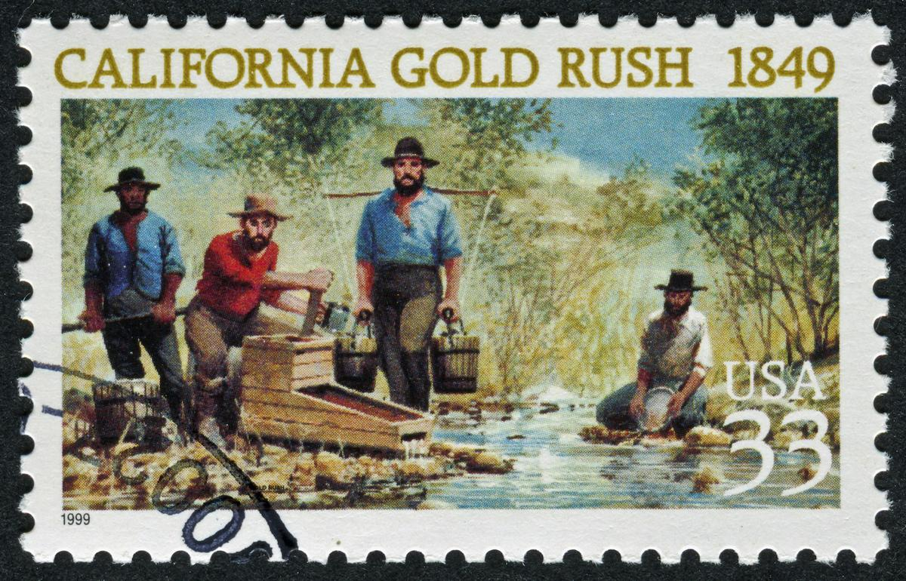
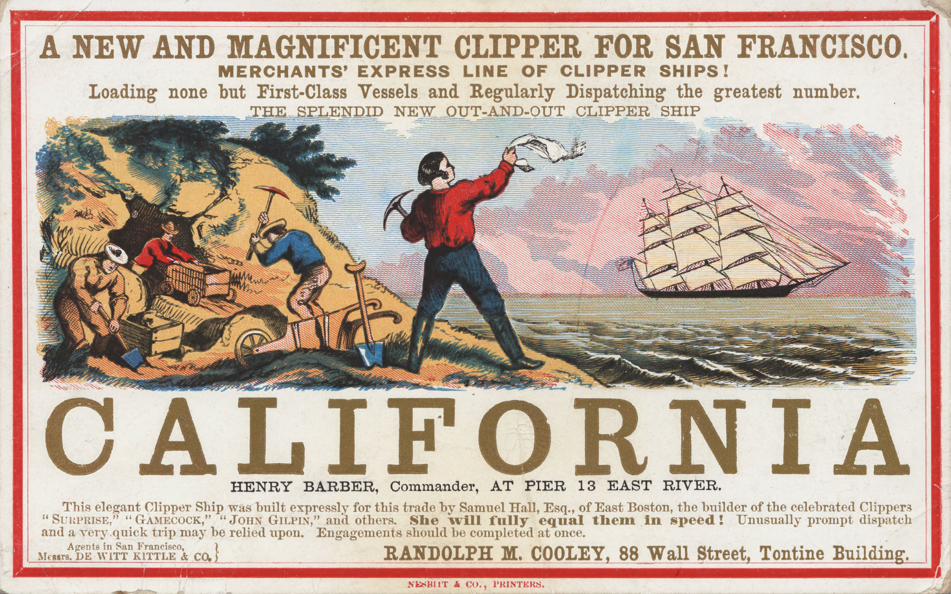
Effects of the Gold Rush...
California and the US as a whole felt the effects of the Gold Rush:
Mining harmed California's environemnt. Timber for mine supports used up forests, chemicals such as mercury caused pollution, and the technique of hydraulic mining (the use of high-powered jets fo water to wash away hillsides and reach the gold beneath) destroyed the landscape.
But mining also kick-started California's development. The non-Native American population rose from around 14,000 to about 225,000 between 1848-1852. Mining towns such as Sacramento and Stockton expanded. San Francisco became the economic centre of California.
The Gold Rush accelerated the economic growth of the US. The wealth generated by gold mining gave America an important role in world trade. Settlement in Califronai increased the need for better links between the east and west fo the country, leading to imporved mail services and a transcontinental railroad.
Mining had a negative impact on many individuals, especailly the Native Americans, but it playeed an important roile on the exaplnsion of the US.

Slide 18
A reminder about questions and timings
4 marks = 5 minutes = 1 paragraph
8 marks = 10 minutes = 2 paragraphs
12 marks = 15 minutes = 3 paragraphs (consider each bullet point in para 1 and 2, and then compare the bullet points in the final paragraph. Be decisive!)

Slide 19
Paper 1 Section A: America, 1840-1895
Exam Questions
How do Interpretations A and B differ? (4)
Why do Interpretations A and B differ? (4)
How convincing are interpretations? (8)
Describe two … (4)
In what ways … Explain your answer (8)
Which of the following were more important? 2 bullet points – could be on causes / consequences (12)

Slide 20
Remember:
Q1 - It's all about the content, about the content. No author!
Q2 - It's all about the author, about the author. No content!
Q3 - It’s all about the content, about the content. Own knowledge!
    Para 1 - say which one is most convincing and why by judging it against own knowledge.
    Para 2 - say which one is less convincing and explain why by judging it against your own knowledge.
    In the last paragraph, sum up. Which one is more accurate/convincing when judged against own knowledge?
Q4 - 'Describe'. Give a brief but precise summary of the key topic addressed in the question. You must make 2 key points and use specific historical knowledge.
Q5 - 'In what ways ..?'. Explain how a key development affected a situation or group of people. 2 x PEE.
Q6 - Para 1: How does Bullet Point 1 answer the question?
  Para 2: How does Bullet Point 2 answer the question?
  Para 3: Compare both bullet points and reach a clear judgement.

Slide 21

Question 1- How interpretations differ?= 4 marks in total
Top Tip:
Read the question and interpretations carefully. They will give you different opinions - important/not important or someone to blame / not to blame
Focus on the content from the sources. They may imply an opinion, so read them carefully!
State and explain how they are different and provide examples from the source.
1 para = 5 mins
Tune – It's all about the base
Question 1: It's all about the content, about the content. No author!

Slide 22
Question 1: How does Interpretation B differ from Interpretation A about the attack on the Indian camp at Sand Creek?
Explain your answer using Interpretations A and B. [4 marks]
Interpretation A:
Interpretation B:
The Indians at Sand Creek were friendly and under ​the protection of Fort Lyon.​ However, Chivington had been planning this attack for weeks. He and his men were to be disbanded and, being in politics, their idea was to win votes by striking one terrible blow at the ‘red rebels’. Chivington’​s troops were the worst sort of ​frontier whites as they were not disciplined and their officers had no control over them. They were united only by their eagerness to kill Indians​.
The Indians at Sand Creek had moved ​away from the pr​otection of Fort Lyon and were raiding wagon trains, stealing livestock, robbing mail coaches and killing white​ people.​ When that “robbers’ Den”​ was cleaned out on that glorious day, t​he soldiers found scal​ps of white people, stolen mail, ​and ​women and children's clothing. It’s​ not surprising that the soldiers acted as they did w​hen they found ​evidence of such barbaric behaviour.​ What Chivington did at Sand Creek saved ​Colorado.​

Slide 23
This would gain the full 4 marks available. Why?
Interpretation A differs from Interpretation B because they both have very different views on what happened at the Sand Creek Massacre. Interpretation B has a very optimistic view of the issue and refers to the opinion that Chivington “saved Colorado”. This differs from Interpretation A as that interpretation because it says things like “officers had no control”, “worst sort of frontier whites”, which gives a more critical view of Chivington and his men. While interpretation B defends Chivington, A suggests that Chivington led a group of white settlers into an Indian camp with the full intention of slaughtering them all.

