Slide 1
Things to watch to extend your knowledge / revision:
Dan Snow Documentary about Pevensey Castle - https://www.dailymotion.com/video/x475keg
360* Tour of Pevensey Castle – www.thinglink.com/video/1087280797645275137
BBC Teach: Series of 6 minute clips about each section of the Norman Conquest. Good for historical context.
  Claimants to the Throne - https://www.youtube.com/watch?v=1sK4JX0co8I&index=2&list=PL4u6ksFXP_7nYeRvAYFTFjhPjC1qLGEIy
  Fulford Gate - https://www.youtube.com/watch?v=m9NdbxQWdJ8&list=PL4u6ksFXP_7nYeRvAYFTFjhPjC1qLGEIy&index=7
  Stamford Bridge - https://www.youtube.com/watch?v=qtW7H7yPZLg&list=PL4u6ksFXP_7nYeRvAYFTFjhPjC1qLGEIy&index=4
  Hastings - https://www.youtube.com/watch?v=zigjVCFzZ38&index=6&list=PL4u6ksFXP_7nYeRvAYFTFjhPjC1qLGEIy
  Securing power - https://www.youtube.com/watch?v=KGDu-_vi8sg&index=5&list=PL4u6ksFXP_7nYeRvAYFTFjhPjC1qLGEIy
  Revolt and Resistance - https://www.youtube.com/watch?v=kNWoXlAZdkM&list=PL4u6ksFXP_7nYeRvAYFTFjhPjC1qLGEIy&index=9

Slide 2
Question 4: 'Statement'. How far does a study of Pevensey Castle support this statement?(16 marks)
Applying all of this to the exam...
How does all that you have learnt about Pevensey Castle, and your contextual knowledge about castles and the Norman conquest and control, link to the exam?

Slide 3
Do Now: What can you remember?
Pevensey Castle Pyramid
Line 1 – One word to sum up the importance of Pevensey
Line 2 –Two reason why the timing of William's landing was shrewd
Line 3 – Three reasons why Pevensey was clearly an advantageous place to land
Line 4 – Four reasons why Normans would support William's risky venture across the Channel
Line 5 – Five reasons why Pevensey was of on-going strategic importance to William
Line 6 – Six words, phrases of expressions associated with the siege of Pevensey
Line 7 – a seven word sentence to explain why William's castle building programme was so successful
Line 8 – Annotate and explain how these 8 individuals played a part in William's struggle for mastery of England

Slide 4
1
2
3
4
5
6
7
8

Slide 5
1
2
3
4
5
6
7
8
Beachhead
Saxons in the North
Tired Saxon Troops
Ready-made Roman fort
Natural Harbour
Defensible
Good soldier sure victory
Papal Crusade
Generous rewards after
Just casue been promised
Gateway in and out
Harold's area - provocative & psyhcological
Prevented other invaders
Mortain makes money
Castles – statement &
technological advantage
Odo +
Robert
6 weeks vs
William
De Warenne
investment
Secures
loyalty
forces
sieges
minimises
repeat
attacks
Odo
Edwin
Morcar
Waltheof
Gospatric
Harold Godwinson
Edgar Aethling
Robert de Montain

Slide 6
AQA Resource Booklet:
Pages 3-5: Background Information
Resources A-H: Photographs / Maps of Pevensey
Resource I: talks about the Rebellions William faced – FUNCTION and LOCATION of castles!
Resource J: talks about the need to defend landscape, the location of castles and fear of attack.
Resource K: Surrounding area and settlement pattern – this thinks beyond the castle itself. FUNCTION and PEOPLE.
Resource L: Establishment of the Sussex Rapes
Resource M: talks about Robert de Mortain – the main man!

Slide 7
Magnificent Seven
The main change that Norman Castles brought about was that they allowed the Normans to defend their new lands.
How far does a study of Pevensey Castle support this statement?
Explain your answer. You should refer to Pevensey Castle and your contextual knowledge. (16 marks)
To support your answer candidates could include aspects of the site such as:
Location
Function
Structure
Design
People connected to the site – owners
How the site reflects culture, values and fashions of the time
How the site links to important events and/or developments of the specified period.

Slide 8
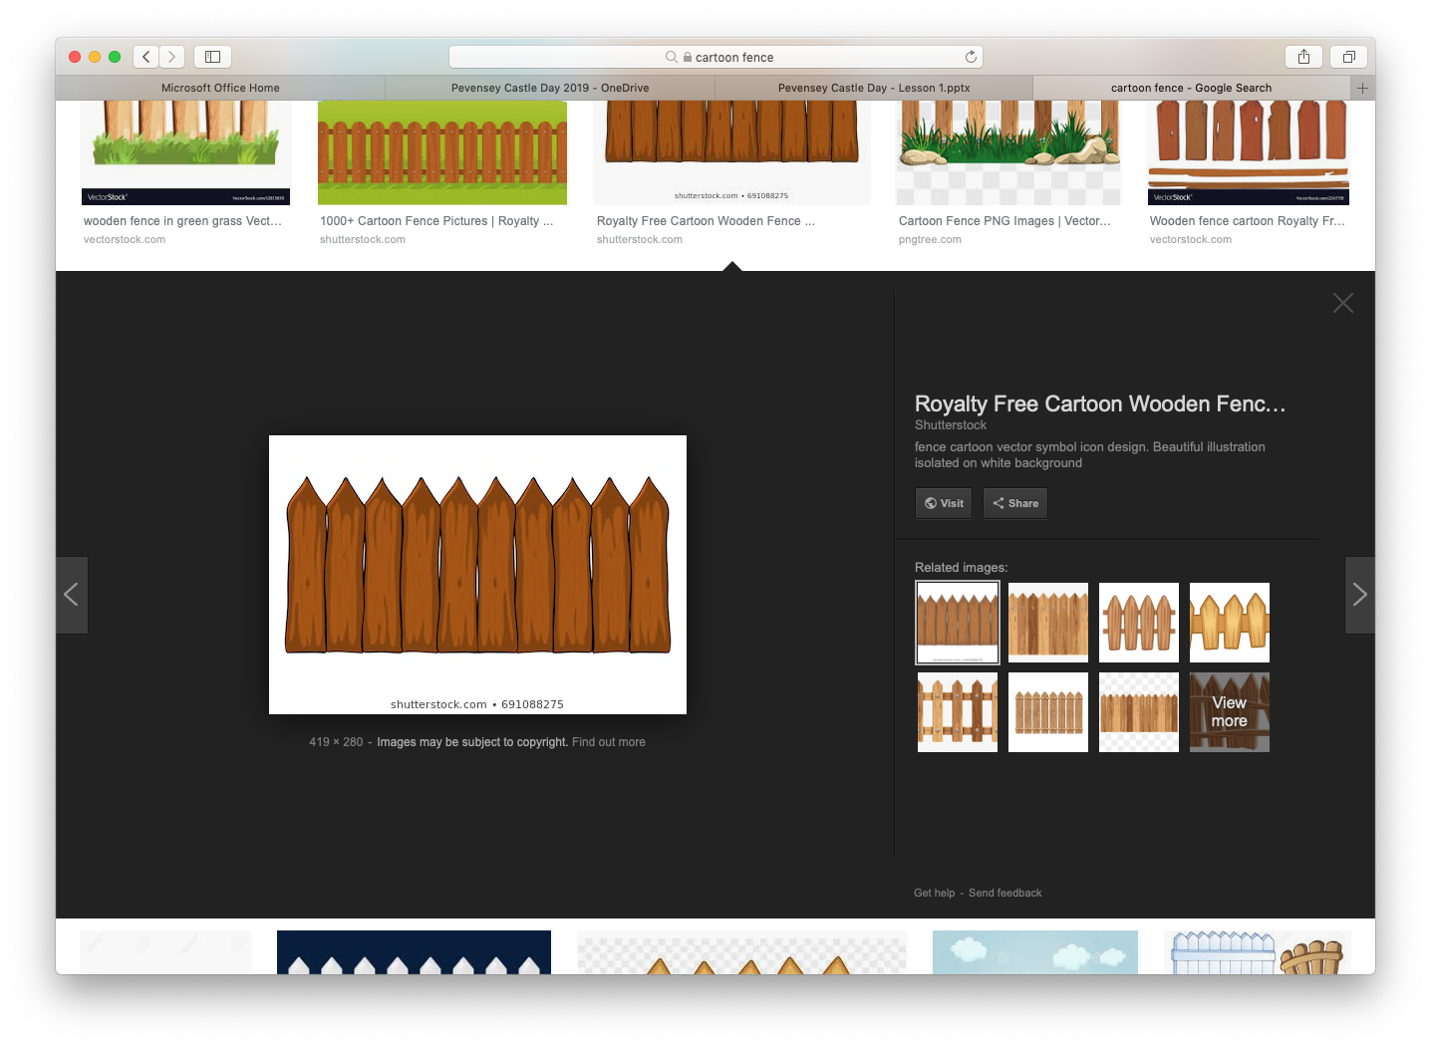
Sitting on the fence can only ever get you one thing. Splinters!

Slide 9
Weighty Words
Making a Judgement
Significance
Importance least important
smallest less important biggest change
most incredible
unimportant valuable vital
Considerable insignificant
momentous non-essential influential
revealing un-substntial
remembered standout great
Resonant salient trivial chief
insubstantial principal imperative
substantial crucial remarkable
paramount exceptional
momentous

Slide 10

Killer Questions
Ali Approach!
What was the Greatest or Main CHANGE?
TOP TRUMPS – Prop them up or knock them out!
Other second order concepts are available … let's take a look.

Slide 11
Cause / Consequence
'The main reason for building castles was to exert political control over the English population'. How far does a study of Pevensey castle support this statement?
'The main reason for building castles was to control trade and commerce'. How far does a study of Pevensey Castle support this statement?
'The main reason for building castles was to defend the Normans and their territory'. How far does a study of Pevensey Castle support this statement?
'The main reason for so many Norman castles being constructed after 1066 was that they allowed the Normans to control the population without the need to use force'. How far does a study of Pevensey Castle support this statement?

Slide 12
Change / Continuity
'The main change that Norman Castles brought about was that they allowed the Normans to defend their new lands'. How far does a study of Pevensey Castle support this statement?
‘The main change Normans brought about was that they increased the building of castles to prevent rebellion and being overthrown’. How far does the study of Pevensey Castle support this statement?
’The main change Normans brought about was that castles were key to controlling the population in England’. How far does the study of Pevensey Castle support this statement?
’The main change Normans brought about through their development of castle building was to ensure that barons made English towns profitable for the king’. How far does the study of Pevensey Castle support this statement?

Slide 13
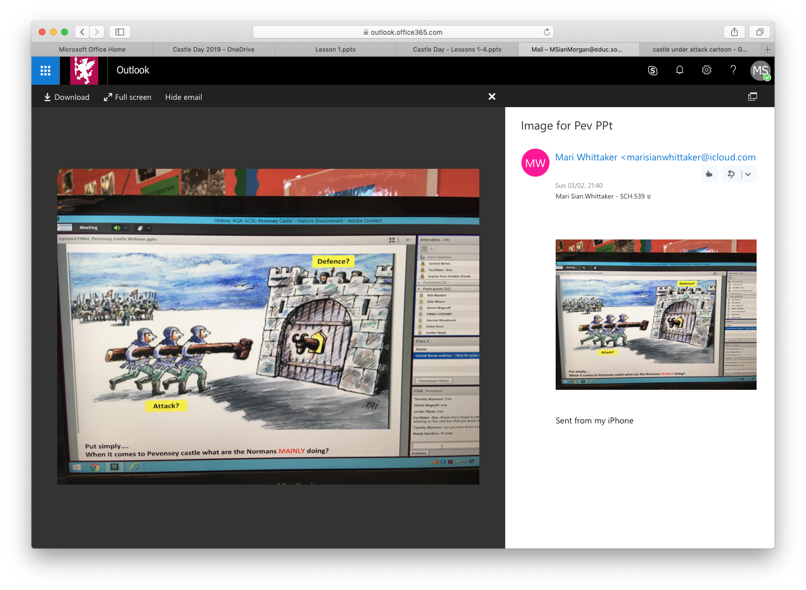
Pevensey Castle....
Defence?
Using it as a base to launch an attack?
Put simply...
When it comes to Pevensey Castle what were the Normans MAINLY doing?

Slide 14

Main Change
Allowed the Normans to defend their lands..
BUT was Pevensey more for lauching an attck?
Personal Authority
Norman nobles organised their own administrations within their territories e.g. Robert de Mortain
Control
A long term symbol of power and control over the native population which deterred rebellion
New Structures
Design wise nothing been seen like this before
Settlement Patterns
Castles acted as catalysts for settlement change and colonisation

Slide 15
Historic Environment Question:
The main change that Norman Castles brought about was that they allowed the Normans to defend their new lands.
How far does a study of Pevensey Castle support this statement?
Explain your answer. You should refer to Pevensey Castle and your contextual knowledge. (16 marks)
Plan an answer using this grid
Para 1: Factor mentioned in the Question e.g. Defend new lands
Judgement:
'Main Issue'
One issue has
greater merit
Main reason / cause. Explain in detail. Decide!
Para 2: Another factor e.g. Control over natives
Para 3: Another contributing factor e.g. Personal Authority
Notes:
Remember – if you held up a mirror to other cathedrals, Durham would fit in. Durham mirrors what was going on in other cathedrals. Must bring in Norman knowledge and use Durham as a yard stick to test knowledge. Cathedrals built for religion, but built for other purposes too.
E.g. Testing limits of architecture - Durham first to have pointed arches but all cathedrals being rebuilt in Romanesque style and had monasteries attached. Some did have castles nearby. But Durham at the forefront of architectural changes e.g. pointed arches.
Religion – St. Cuthbert's shrine, place of pilgrimage and monasteries (housed monks from benedictine order) - very much like other cathedrals / monasteries.
Imposition of power – Location (strategically placed as put in places of rebellions) but Prince Bishop slight difference as not Bishop.

Slide 16
The main change that Norman Castles brought about was that they allowed the Normans to defend their new lands. How far does a study of Pevensey Castle support this statement?
Explain your answer. You should refer to Pevensey Castle and your contextual knowledge. (16 marks)
The establishment of castles was one of the most visible and lasting changes made by the Normans. These big new structures were in themselves imposing weapons designed to defend invaded territory, and ensure their lasting hold on and control of this new conquered land. The castle at Pevensey had dual purpose of defence and attack. The chosen site was easy to defend, a peninsular with a natural harbour, a safe beaching surrounded by sea and salt marsh.
Strategically, Pevensey was a highly provocative location to attack since it was Harold Godwinson's territory. Invading Harold's land was a big change which would send shock-waves through English society. This aggressive move would arguably make it more likely that Harold would quickly rush with his tired troops from Yorkshire to defend his earldom giving William the advantage and ultimately new control over the population.
The location of Pevensey Castle represents continuity too in that the Normans made use of the pre-existing Roman remains of the fort of Anderida. The geographical advantages of a beachead site with ready-made oval encircling Roman walls provided immediate shelter for the attackers when they landed on 28th September 1066, three days after King Harold's victory at Stamford Bridge. The pre-existing undefended shell was immediately customised to allow the Normans as heirs to the Romans to create the modern French phenomenon, the castle. The size of the site was reduced from a communal fortress, to quickly erect a 'flat pack fortress', so Pevensey was a short term place of attack. William now had the required toe hold in England from which to launch his conquest.

Slide 17
IN 1067 William sailed back out of Pevensey on a triumphal tour of Normandy. He was now King of England as well as Duke of Normandy, his attack at Hastings had resulted in victory. Another change that the arrival of castles brought was the alteration to settlement patterns to enable security and lasting control of the new territory. In the case of Sussex it seems William adopted a 'divide and conquer' policy. He divided the land around Pevensey into 5 Rapes (a type of military district) and gave the Rape of Pevensey to his half-brother Robert, Count of Mortain. It was probably Robert who created the first permanent defences re-fortifying the Roman outer wall and creating two baileys within it , divided by a ditch and timber pallisade. By 1086 each of the Rapes had created a castle, perhaps a preventative emergency measure to establish control and guard against resistance in this area as William had faced rebellion on a huge scale in the north. (See Resources I and L)
The King's allocation of Pevensey to Robert de Mortain meant that he could then look to the longer term. This Norman power holder could capitalise on how the civilian population had been overawed and push forward with commercial expansion. In Pevesney the relationship between castle and rents revenues tripled accordingly. Mortain had the monopoly on salt making and 24 works were recored on his coastal manors. (See Resource M)

Slide 18
In judgement, in the case of Pevensey Castle the main change was actually how the castle was used by William to anchor personal authority and control in the south of his newly invaded kingdom of England, and not one of defence. Vital to William's plans, Pevensey was the place he established a foothold, the launch pad for the conquest. It was his gateway to and from the continent. From here he made his mark and then established the standard procedure of handing over control of the castle to a loyal and trusted follower; Robert de Mortain, who then had the incentive to extend the area of control and revenues thus further consolidating the conquest. It became part of the machinery of defence, but Pevensey was mainly a place of attack and control.

Slide 19
(yellow highlight) the answer opens by directly addressing the factor which is given in the question.
(green highlight) Later paragraphs open with another factor which is relevant to the issue in the question.
(dark blue highlight) The answer also gives specific knowledge about the site which supports the point given in the opening sentence.
(light blue highlight) The argument in the paragraph is then supported by a range of detailed, specific own knowledge.
(purple highlight) Here the paragraph links the evidence to the issue in the question.
(red highlight) The answer closes with a final judgement which carefully weighs up the role of the given factor against other factors.

Slide 20
Another possible answer. This time to a cause / consequence question, but with same factor focus i.e. defence of land ...
“The main reason for building castles was to defend the Normans and their territory.”​
How far does a study of Pevensey Castle support this statement?
A study of Pevensey Castle supports this statement to an extent.
One reason for building castles was indeed to defend the Normans and their territory. They had invaded in 1066 and killed Harold II. They needed castles quickly to protect the Norman nobility and garrisons from repeated English rebellions. For example, Pickering Castle was built after the Northern Revolt of 1069. We can see this at Pevensey. William built a castle immediately upon arrival to protect his invading army and then Robert of Mortain strengthened it in the 1080s, building an inner bailey with palisade and repairing the outer Roman walls. However, when Pevensey was involved in a rebellion, it was used to protect the rebels rather than defend against them! In 1088, William II had to besiege Mortain there because he was supporting William’s brother, Robert Curthose. Castles also served to protect against invasion. For example, castles were built at Durham and Newcastle to defend against the Scots and many were built along the Welsh border by the Marcher Lords. We can see this at Pevensey. The castle was built to defend a vulnerable natural harbour on the south coast which William had used during his own invasion and in 1101, Henry I spent the summer at Pevensey to defend against a potential invasion by his brother, Robert Curthose. However, this wasn’t a new idea. The walls at Pevensey were actually the remains of a much older Roman fort built there in the third century as part of a network of nine coastal forts known as the Saxon Shore.

Slide 21
However, a study of Pevensey Castle also reveals that a second reason for building castles was to exert socio economic control. Castles controlled the movement of people and trade. They were often built near transport routes such as rivers and roads. We can see this at Pevensey. The castle guarded a harbour and entrance to a river. By 1086, Pevensey was therefore making Robert of Mortain £4 a year in tolls and a further £5 a year from the many saltworks trading in the area. Castles were also often used to administer the Normans’ estates. It was from the castle that roles would be organised and to the castle that produce would be brought. Castles attracted tradesmen and craftsmen and acted as economic hubs. We can see this at Pevensey. The small borough there flourished under Mortain and, by 1086, it had over 100 burgesses and was making him £3 a year in tax and a further £1 from its mint. However, Mortain did not create the borough. It had already existed pre-Conquest when it was making £1 a year for Edward the Confessor.
A study of Pevensey Castle also reveals that a third reason for building castles was to exert political control. Castles had enormous propaganda value. They were huge constructions in the centres of many towns, built by forced labour and often on land cleared of English homes. At Lincoln, a seventh of the town was flattened. Castles suggested the Norman lords were here to stay. We can see this at Pevensey. The land around the castle was seized permanently from English landowners, granted to loyal supporters of William and divided into five ‘rapes’ with a castle in each. However, the Norman lords of Pevensey weren’t always loyal. In 1101, Robert’s son, William of Mortain, had the castle stripped from him by Henry I. Castles could also project a message of continuity. They were often built alongside existing fortifications such as at Winchester, where the castle was within the Roman walls, or at Colchester, where the castle was built on the ruins of the Roman Temple of Claudius. The Normans liked to draw parallels between themselves and those earlier conquerors, the Romans. We can see this at Pevensey. The castle there was built within the remains of the Roman fort and the walls were repaired and strengthened.

Slide 22
In conclusion, a study of Pevensey Castle reveals that the main reason for building castles was indeed to defend the Normans and their territory. Although castles exerted socio-economic control, the ultimate aim of doing so was to make the English dependent on the Normans’ presence and therefore less likely to rebel. Although castles exerted political control, the ultimate aim of doing so was to dissuade the English from attempting to rebel. The main reason, therefore, for building a castle was to defend the Normans and their territory by either preventing rebellions in the first place or defending against them when they occurred.
Do you agree with this??? Was it not a place for Willian to launch his attack on England? You decide!

