Slide 1
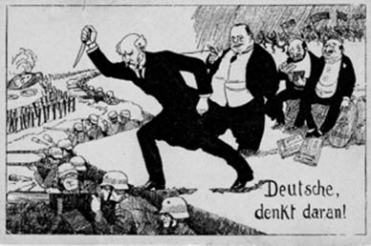
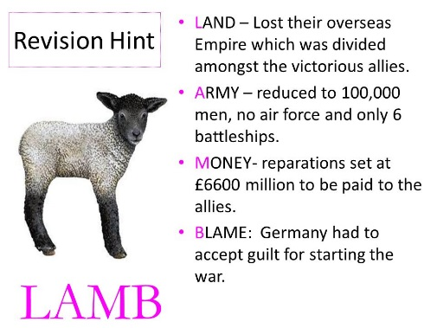
Knowledge Organiser: Weimar and Nazi Germany 1918-39 Part 1: The Weimar Republic, 1918-29
The Weimar Republic
1 | This was the name given to Germany after the Kaiser had abdicated in November 1918. This was a time of despair and hope for Germany. At first, the country faced lots of chaos but under Gustav Stresemann, there was some stability.
Key events
2 | November 1918 World War One ended. The Kaiser abdicated and Germany became a country without a monarch (a Republic). The new government signed the armistice (end of war).
3 | 1919 January Spartacist Uprising – communists wanted workers not the government to rule Germany.
4 | 1919 June The government signed the Treaty of Versailles (DIKTAT) & have to accept terms LAMB
5 | 1920 Kapp Putsch – the right wing with support of the Freikorps attempt to takeover the government
6 | 1922 German government stop paying reparations as cannot afford repayments
7 | 1923 French invade and occupy the Ruhr
8 | 1923 The government encourages passive resistance of Ruhr Workers, and prints $$ to pay their wages, leading to hyperinflation
9 | Stresemann comes to power, and introduces new bank notes
10 | 1924 Dawes Plan – loans from USA
11 | 1925 Locarno Pact
12 | 1926 Germany joins League of Nations (peace keeping body)
13 | 1928 Kellogg Briand Pact – agreement to not resort to war
14 | 1929 Young Plan- reduction of payments
Key Concepts
15 | The Weimar Republic faced much opposition, It was disliked by the left wing who wanted Germany to be like Communist Russia and it was disliked by the right wing who wanted the monarchy back.
16 | The Treaty of Versailles caused many problems for Germany. The German people disliked the politicians for signing it and it caused political problems and economic problems.
17 | Gustav Stresemann helped to bring about recovery in Germany after 1924. He solved economic problems by making friends with other countries. However, historians have very different views about the extent of this recovery.
18 | The Golden Age was the period from 1924-29 and it saw significant changes in culture, the standard of living and the position of women.
Exam Questions​​
Give two things you can infer from Source A about…. (4 marks )
Explain why…(12 marks)
3a How useful are Sources B and C for an enquiry into… (8 marks )
3b Study Interpretations 1 and 2……. What is the main difference between the views? 4 marks)
3c Suggest one reason Interpretations 1 and 2 give different views about ….(4 marks)
3d How far do you agree with Interpretation 2 about … (16 marks) plus 4 marks SPAG
Key Words
19 | Armistice | An agreement to end World War 1 1918. Germany surrendered to France, GB and USA
20 | Republic | A country ruled by a government (no king/Queen)
21 | Dolchstoss | Stab in the Back ! People believed that the government had betrayed them by ending war
22 | November Criminals | The government , for ending the War were called this.
23 | Ebert | The first President of the Republic
24 | Stresemann | The Chancellor of Germany from the Summer of 1923 – ended HI and improved relations with neighbouring countries
25 | Article 48 | If decisions could not be agreed upon the president could use this power (and did increasingly after 1929 – 1932)
26 | Kaiser | King
27 | Weimar | The new government could not meet in Berlin as it was so dangerous, so they met here instead
28 | Constitution | This is an agreement about how the country would be ruled. Germans all had the vote (over 20), voting was done by proportional representation (meaning every party had a say in how the country was run). It was difficult to make decisions quickly – so the government looked weak and indecisive (1929 onwards)
29 | Reichstag | German parliament
30 | Diktat | The Germans believed that the Peace treaty of 1919 was a dictated peace (forced)
31 | Freikorps | Ex military soldiers who wanted to overthrow the Weimar Republic and replace with one strong leader.
32 | Rentenmark | The currency of Germany replacing worthless money in November 1923
33 | Hyperinflation | When money loses its value
34 | Dawes Plan | An agreement where the USA would lend Germany money $$$$$
35 | Young Plan | This lowered the reparations payment and gave Germany longer to pay
36 | Treaty of Versailles | This “agreement “ was set out to determine how Germany was going to be treated after WW1 – loss of land, reuction of army, money payment and blame for the entire war.
37 | Locarno Pact | An agreement on borders signed by Britain, France, Italy and Belgium
38 | Kellogg Briand Pact | 65 counties including Germany agreed to resolve conflict peacefully
39 | Coalition | A government of two or more political parties – very common during Weimar Germany
40 | Democracy | Rul where everyone has a say in how their country is run.
Stab in the back myth- many believed that the government had betrayed Germany by ending the war.

Slide 2
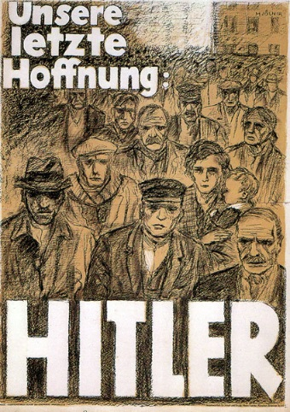
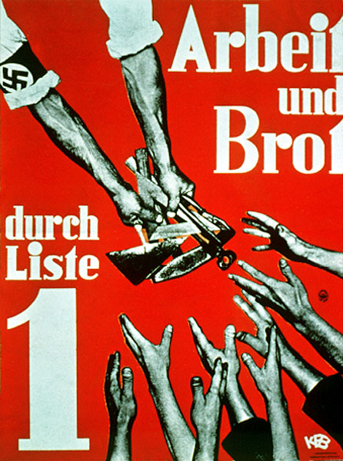
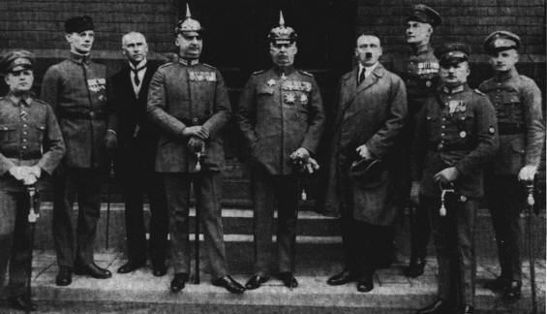

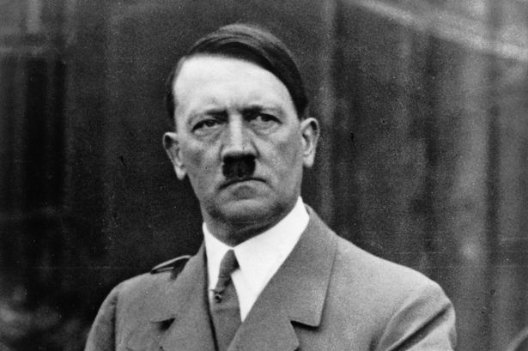
Knowledge Organiser: Weimar and Nazi Germany 1918-39 Part 2: Hitler’s Rise to Power, 1919-33
Exam Questions​​
Give two things you can infer from Source A about…. (4 marks )
Explain why…(12 marks)
3a How useful are Sources B and C for an enquiry into… (8 marks )
3b Study Interpretations 1 and 2……. What is the main difference between the views? 4 marks)
3c Suggest one reason Interpretations 1 and 2 give different views about ….(4 marks)
3d How far do you agree with Interpretation 2 about … (16 marks) plus 4 marks SPAG
Hitler’s Rise to Power
1 | Hitler sets up the Nazi Party in 1920 and becomes Chancellor in January 1933. This happens for a variety of reasons – Hitler’s strengths, weaknesses of the Weimar Republic, and other problems.
Key events
2 | 1919 Hitler joins the German Worker’s Party
3 | 1920 Hitler sets up the Nazi Party
4 | 1921 Hitler introduces the SA
5 | 1923 The Munich Putsch
6 | 1925 In jail Hitler wrote Mein Kampf published
7 | 1926 Bamberg Conference
8 | 1928 Nazis win 12 seats in Reichstag
9 | 1929 Death of Stresemann and Wall Street Crash
10 | 1930 Nazis win 107 seats in Reichstag
11 | 1932 July Nazis win 230 seats in Reichstag
12 | 1932 November Nazis win 196 seats in Reichstag
13 | 1933 January Hitler becomes Chancellor
Key Concepts
14 | The Munich Putsch is a significant event. Although a failure, Hitler gained publicity, he wrote Mein Kampf and he realised that if he was to win power, he needed to do this by votes and not by force.
15 | Stable Stresemann caused problems for the popularity of the Nazi Party. When times were good, voters were not attracted to the Nazi policies.
16 | The Wall Street Crash was a major turning point in the fortunes of the Nazi Party. The Nazi message did not change but people were now prepared to hear it.
17 | Political Intrigue -Hitler was handed power by political elites Von Papen and Hindenburg who feared a Communist take over.
Key Words
18 | NSDAP | The Nazis
19 | Ideology | Ideas, values
20 | Volk | The notion of pure German people
21 | 25 Point Programme | The political manifesto of the Nazi Party
23 | Fuhrerprinzip | Belief that one person should run a Party
24 | Swastika | Emblem of the Nazi Party
25 | SA or Sturmabteilung | Private army of the Nazi Party headed by Rohm – known as the brown shirts.
26 | Aryan | Pure German people – blonde hair, blue eyes.
27 | Anti-Semitism | Hatred of the Jewish people
28 | Mein Kampf | Hitler’s autobiography
29 | Putsch | An attempt to get power illegally
30 | Blood Martyrs | 16 Nazis who died at the Munich Putsch
31 | Gau | Local Nazi party branches. Goebbels was Gauletier for Berlin.
32 | SS | Hitler’s bodyguards – black shirts
33 | KPD | German Communist Party
34 | Propaganda | Goebbels created information, biased or misleading nature, used to promote a political cause or point of view.
35 | Hindenburg | The President of the Republic from 1925 to 1934

Slide 3
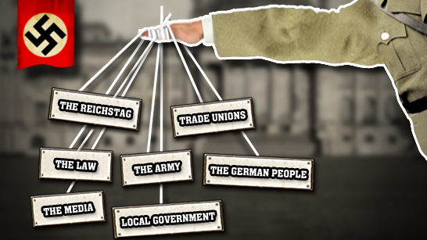
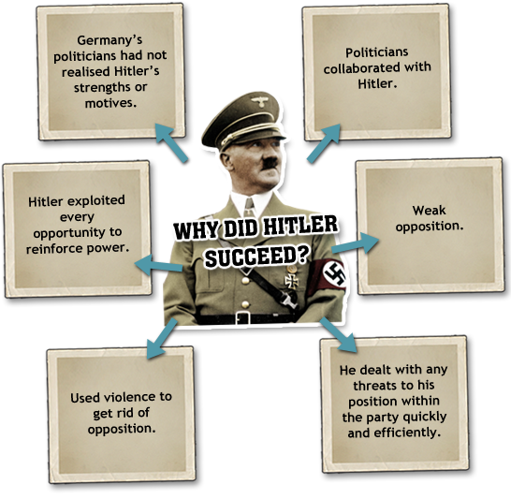
Knowledge Organiser: Weimar and Nazi Germany 1918-39 Part 3: Nazi Control and Dictatorship
Nazi Control and Dictatorship
1 | This was a time when Hitler formed a legal dictatorship and put in place methods of propaganda and censorship and a police state to persuade and encourage all Germany people to support Nazi ideals.
Key events
2 | 1933 January Hitler becomes Chancellor
3 | 1933 February Reichstag Fire
4 | 1933 March Nazis win 288 seats
5 | 1933 March Enabling Act passed
6 | 1933 July Nazis become the only legal party in Germany
7 | 1934 June Night of the Long Knives
8 | 1934 August President Hindenburg dies
9 | 1934 August Hitler combines the post of Chancellor and President and becomes Fuhrer
10 | 1934 August German army swears allegiance to Hitler
11 | 1938 Over the course of the year, Hitler removes 16 army generals from their positions
Key Concepts
12 | Removal of all opposition – From 1933 to 1934, Hitler removed all opposition and established himself as Fuhrer.
13 | Control – There was an attempt to control and influence attitudes. This was done by propaganda and terror.
14 | Opposition – The youth and the churches opposed the regime.
Exam Questions​​
Give two things you can infer from Source A about…. (4 marks )
Explain why…(12 marks)
3a How useful are Sources B and C for an enquiry into… (8 marks )
3b Study Interpretations 1 and 2……. What is the main difference between the views? 4 marks)
3c Suggest one reason Interpretations 1 and 2 give different views about ….(4 marks)
3d How far do you agree with Interpretation 2 about … (16 marks) plus 4 marks SPAG
Key Words
15 | Marinus van der Lubbe | The Reichstag Fire was blamed on this Communist
16 | Enabling Act | Gave the Nazis full power for the next 4 years
17 | Gleichschaltung | Hitler’s attempt to bring German society into line with Nazi philosophy
18 | German Labour Front (DAF) | Set up to replace Trade Unions
19 | Dachau | First concentration camp
20 | Centralisation | Germany had been divided into districts called Lander. Now Germany was run from Belin alone
21 | Purge | To get rid of opposition
22 | Gestapo | Secret police headed by Goering.
23 | Night of the Long Knives | Removal of SA leaders from the Nazi party by the SS (black shirts). This led to the army swearing an oath of loyalty to Hitler.
24 | Sicherheitsdienst (SD) | The intelligence body of the Nazi Party
25 | Concordat | In July 1933 the Pope agreed to stay out of political matters if the Nazis did not interfere with Catholic affairs
26 | Swing Youth | Groups who apposed the Hitler Youth
27 | Confessional Church | The church refused to allow the Nazification of religion. Led by Pastor Martin Niemoller

Slide 4
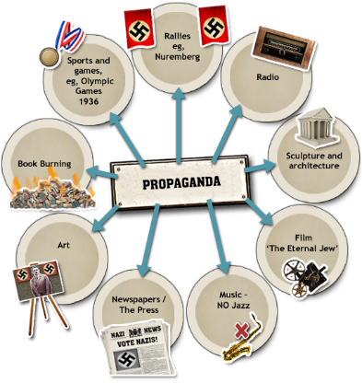
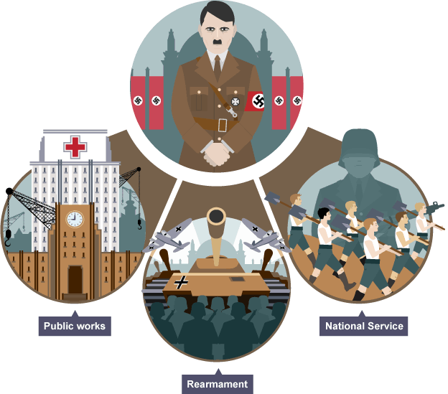
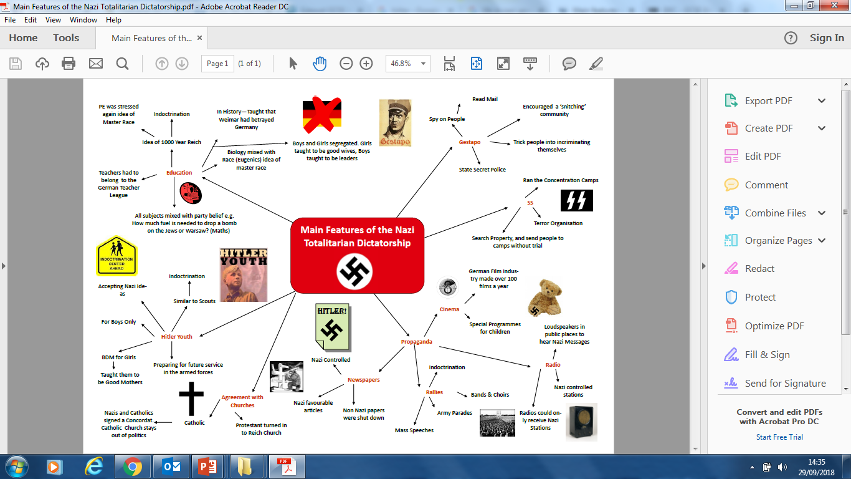
Knowledge Organiser: Weimar and Nazi Germany 1918-39 Part 3: Life in Nazi Germany, 1933-39
Exam Questions​​
Give two things you can infer from Source A about…. (4 marks )
Explain why…(12 marks)
3a How useful are Sources B and C for an enquiry into… (8 marks )
3b Study Interpretations 1 and 2……. What is the main difference between the views? 4 marks)
3c Suggest one reason Interpretations 1 and 2 give different views about ….(4 marks)
3d How far do you agree with Interpretation 2 about … (16 marks) plus 4 marks SPAG
Life in Nazi Germany
1 | The lives of German citizens were changed after Hitler’s appointment as Chancellor. For some, life was better under the Nazis but for others, it was much worse.
Key events
2 | 1933 Boycott of Jewish shops and businesses. Law for the Encouragement of Marriage. Sterilisation Law passed.
3 | 1935 The Nuremberg Laws were passed.
4 | 1935 Conscription introduced.
5 | 1936 Membership of the Hitler Youth made compulsory.
6 | 1938 Jewish children were not allowed to attend German schools. Lebensborn programme introduced. Kristallnacht.
7 | 1939 The euthanasia campaign began. Designated Jewish ghettos established.
Key Concepts
9 | Anti-Semitism – Persecution of the Jews grew continuously after 1933.
10 | Young– The Nazis placed much emphasis on controlling the young as only then could they secure a ‘thousand year Reich’. Youth organisations and education indoctrinated the German youth.
11 | Women – The Nazis had traditional family values but even these were tested by the needs of war and the desire to ensure a growing Aryan population.
12 | Living Standards – The Nazis did reduce unemployment but they did this by banning Jews and women from the workplace and by putting Germany on a war footing. Workers had limited rights.
Key Words
13 | Kinder, Kuche, Kirche | Children, Kitchen, Church. This summed up the Nazi ideal of womanhood
14 | The Motherhood Cross Award | Given to women for large families
15 | Lebensborn | Where unmarried women were impregnated by SS men.
17 | Nazi Teachers League | All teachers had to swear an oath of loyalty to the Nazis
18 | Reich Labour Service | A scheme to provide young men with manual labour jobs
19 | Invisible unemployment | The Nazi unemployment figures did not include women, Jews, opponent and unmarried men under 25
20 | Autobahn | Motorway
21 | Rearmament | Building up the armed forces I readiness for war
22 | Volksgemeinshaft | The Nazi community
23 | Strength Through Joy | An attempt to improve the leisure time of German workers
24 | Beauty of Labour | Tried to improve working conditions of German workers.
25 | Volkswagon | People’s car
26 | Herrenvolk | The master race or the Aryans
27 | Nuremberg Laws | Jews were stripped of their citizenship rights and marriage between Jews and no Jews was forbidden
28 | Kristallnacht (Night of the Broken Glass) | A Nazi sponsored event against the Jewish community

